Slide 1

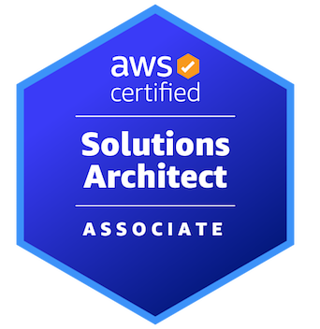

AWS CERTIFIED SOLUTIONS ARCHITECT - ASSOCIATE
Networking
AMBER ISRAELSEN
Developer | Technical Trainer
Notes:
m6-01 = “Module Introduction”
Hi everyone, and welcome back! This is the AWS Certified Solutions Architect Associate course, and I’m Amber Israelsen.

Slide 2
Course Outline (Part 1)
Course Introduction
AWS Cloud Practitioner Refresher
Authentication and Authorization – Identity and Access Management (IAM)
Compute
Elastic Load Balancing and Auto Scaling
Networking
Storage
Databases
Data Migration and Transfer
Analytics
Notes:
We’re moving right along in the course. In the last module, we talked about the various Compute services. And now we’re up to the Networking section, which is going to be pretty extensive. We’ll go over some basic concepts like the virtual private cloud or VPC, and then we’ll dive into more advanced concepts like subnets, route tables, network address translation and a lot more.
So let’s go.

Slide 3
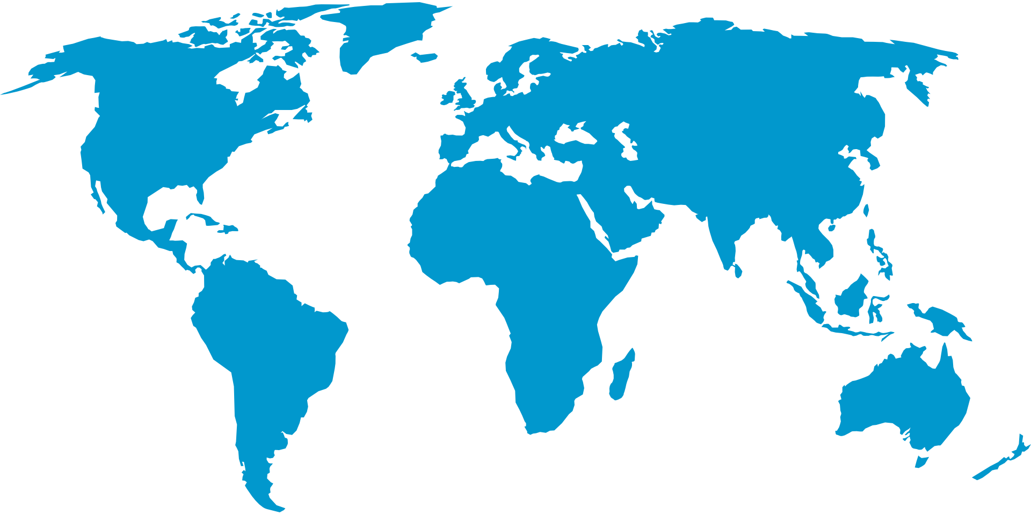
MINE!
Notes:
m6-02 = “Virtual Private Cloud (VPC) Overview”
Show this: https://aws.amazon.com/about-aws/global-infrastructure/regions_az/
As we kick off, let’s just do a little bit of review on the virtual private cloud, or VPC and why we even have them.
As you know by now, AWS is huge, and there are regions and availability zones (click through the tabs), and edge locations around the world.
Back to slides…
And as you can imagine, there are hundreds of thousands, even millions of customers using AWS every day. They’re using EC2 instances and S3 buckets and databases and so on. And you don’t want to just throw your resources out there with all the other millions of resources—a soup of servers and so on.
Instead, you want your own private little slice (click) of the overall AWS pie. And that’s basically what a Virtual Private Cloud, or VPC is.

Slide 4
Virtual Private Cloud (VPC)
Your own private cloud/network within the cloud
Isolates your resources from everyone else’s
Notes:
It’s your own (click) private cloud or network within the cloud—within AWS. And it’s how (click) your resources are isolated from everyone else’s.
If we go out to the Console, go to VPC, you’ll see we have one here. When you create your AWS account, you’ll get a default VPC and then, of course, you can create others.
And when you go to create an EC2 instance, for example (do this, get to third page), you’ll see here under Network that we select a VPC, which in our case is the default VPC. So if we were to go all the way through and launch this instance, it would live within our own little private network in AWS.
Now, if you’re fairly comfortable with VPC concepts, feel free to skip ahead to the next clip. But if you need a refresher, I think my parking log analogy will help…

Slide 5
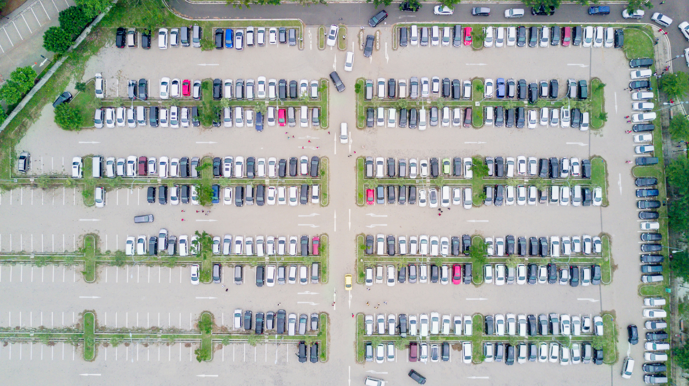
Notes:
So here’s a parking lot—you’re all familiar. And outside of the parking lot is the whole world—AWS world, let’s say.

Slide 6
VPC
VPC
VPC
VPC
VPC
Notes:
So the fence or border around the parking lot can be thought of as your VPC—it separates your resources from the rest of the resources in AWS.

Slide 7

VPC
VPC
Internet Gateway
VPC
VPC
VPC
Notes:
Up at the top here, we have traffic coming in from the outside world, and traffic going out to the outside world. In AWS networking terms, this would be an Internet Gateway. That’s how your VPC can talk to the Internet.

Slide 8
VPC
VPC
Internet Gateway
SUBNET
SUBNET
VPC
VPC
VPC
Notes:
And then inside the VPC, we have logically separated areas—for our example, we’ll say the left and right of the parking lot. These are our subnets. And in AWS land, these are usually used for different purposes.

Slide 9
VPC
VPC
Internet Gateway
SUBNET
SUBNET
Defined in a route table
Route
VPC
VPC
VPC
Notes:
Now, let’s say that one subnet has a ROUTE (or route…pronounced a different way) to get to the Internet. And these are defined in a route table. If you see that term, the table is just where you add the routes you want.

Slide 10
VPC
VPC
Internet Gateway
SUBNET
PUBLIC
SUBNET
Route
VPC
VPC
VPC
Notes:
If that’s the case, then this is a public subnet.

Slide 11
VPC
VPC
Internet Gateway
PRIVATE SUBNET
PUBLIC
SUBNET
Route
VPC
VPC
VPC
Notes:
The other side, the subnet that DOESN’T have a route to the Internet is a Private subnet. That’s the main distinction.
So maybe in the public subnet, you put web servers that host public-facing pages, and in the private subnet, you’d place your databases so there’s an extra layer of security from the outside world.
Okay, hopefully that analogy was helpful for understanding the overall concept of a VPC. Now let’s combine that knowledge with some of the things we already know about the overall AWS infrastructure.

Slide 12



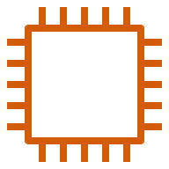

Region
Availability Zone 1
Availability Zone 2
VPC (regional, spans AZs)
Public subnet
(tied to AZ, accessible from internet)
Public subnet
(tied to AZ, accessible from internet)
Private subnet
(tied to AZ, NOT accessible from internet)
Private subnet
(tied to AZ, NOT accessible from internet)
Notes:
(click) First we have a region, as we’ve seen before—this is something like us-west-1 or eu-west-2.
(click) Then within that, we have availability zones—or basically data centers within the region—and two or more per region. This is something like us-east-2a, 2b, 2c and so on.
(click) Your VPC is tied to a single region, and it spans two or more availability zones.
(click) And then going down one more level, we have subnets (click)—again, those different partitions of the VPC. These are tied to an AZ—so you have subnets for the first AZ and more subnets for the second AZ. There are public and private subnets, and to reiterate, the main distinction is that public subnets are accessible from the internet, and private subnets aren’t.
(click) And then within the subnets are where the actual resources live—your EC2 instances and so on. Again, going back to the Console, when you create the instance, not only do you select your VPC, but you also specify the subnet.
Back to slides
So from a big-picture perspective, this will be a good reference slide for you to understand how everything fits together.
Now let’s talk about cider.

Slide 13
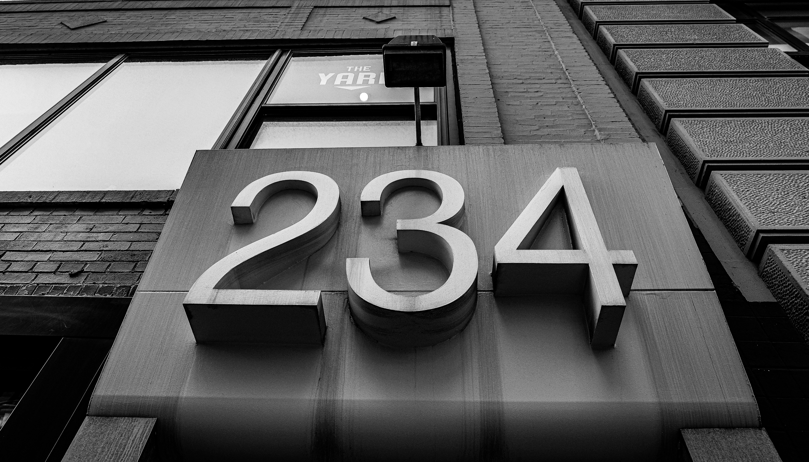
IP ADDRESSING IN AWS
Notes:
m6-03 = “Private, Public and Elastic IP Addresses”
Have open: An EC2 instance (a WEB SERVER with a simple web page, open on Port 80), ready to show its public and private IP addresses
#!/bin/bash
# User data for new EC2 instances
# install httpd (Linux 2 version)
yum update -y
yum install -y httpd
systemctl start httpd
systemctl enable httpd
echo "<h1>Hello World! This is $(hostname -f)</h1>" > /var/www/html/index.html
Now let’s talk about addresses. Specifically, public, private and elastic IP addresses and how they work in AWS.
Show instance
Here I have an EC2 instance that I spun up, and you might have noticed these instances have a public IP address (IPv4 in this case) and a private IP address. And I DON’T have one for this particular instance, but you’ll also see a place for Elastic IP. What do all these mean?

Slide 14

Notes:
I’m sure you’ve heard, an IP address is like an address for a person or a house, except it’s for a computer. And that’s true. But I’m going to tweak that analogy just a little bit to hopefully make better sense of the public, private and elastic IP concepts.

Slide 15
There are several ways to identify a person
Nickname
Full name
Social Security Number/national identifier
Email address
Phone number
Notes:
First, I think we can all agree that there are several ways to identify a person—things like nickname, full name, a SSN or other national identifier, email address, phone number, and so on. Well, the same is true of resources in AWS, where there are multiple IPs.

Slide 16
EXAMPLE | PRIVATE | PUBLIC | ELASTIC
PERSON | Nickname Used only by close friends and family (the private “network”) | Cell Phone Number Anyone can use it to reach you But only temporary (you can get a new number) | Social Security Number Uniquely identifies you and never changes
AWS EC2 INSTANCE | Private IP Address Used to identify resources on a private network (can’t reach from the Internet) | Public IP Address Accessible to anyone over the Internet But only temporary (changes when you stop/start an instance) | Elastic IP Address A static public IP (i.e., doesn’t change) Can be attached to an instance
Notes:
So keeping with our example of a person, a nickname would be a private piece of information. This is only going to be used by close friends and family; the private network, if you will.

Slide 17
EXAMPLE | PRIVATE | PUBLIC | ELASTIC
PERSON | Nickname Used only by close friends and family (the private “network”) | Cell Phone Number Anyone can use it to reach you But only temporary (you can get a new number) | Social Security Number Uniquely identifies you and never changes
AWS EC2 INSTANCE | Private IP Address Used to identify resources on a private network (can’t reach from the Internet) | Public IP Address Accessible to anyone over the Internet But only temporary (changes when you stop/start an instance) | Elastic IP Address A static public IP (i.e., doesn’t change) Can be attached to an instance
Notes:
For an AWS EC2 instance, the equivalent would be a private IP address. This is used to identify resources on a private network within AWS. In other words, you can’t reach it from the internet. If I were to go back out to the Console (do this) and try to open the private IP address, nothing would happen (show). And you might also note that there isn’t an “open address” link like on this one like there is for the public IP address.

Slide 18
EXAMPLE | PRIVATE | PUBLIC | ELASTIC
PERSON | Nickname Used only by close friends and family (the private “network”) | Cell Phone Number Anyone can use it to reach you But only temporary (you can get a new number) | Social Security Number Uniquely identifies you and never changes
AWS EC2 INSTANCE | Private IP Address Used to identify resources on a private network (can’t reach from the Internet) | Public IP Address Accessible to anyone over the Internet But only temporary (changes when you stop/start an instance) | Elastic IP Address A static public IP (i.e., doesn’t change) Can be attached to an instance
Notes:
Back to our slide. For a person, a public piece of identifying information would be a cell phone number. Anyone can use it to reach you. BUT this IS only temporary. In other words, you might get a new cell phone number tomorrow or next year or whenever. But it’s public and anyone with the number can reach you using that number.

Slide 19
EXAMPLE | PRIVATE | PUBLIC | ELASTIC
PERSON | Nickname Used only by close friends and family (the private “network”) | Cell Phone Number Anyone can use it to reach you But only temporary (you can get a new number) | Social Security Number Uniquely identifies you and never changes
AWS EC2 INSTANCE | Private IP Address Used to identify resources on a private network (can’t reach from the Internet) | Public IP Address Accessible to anyone over the Internet But only temporary (changes when you stop/start an instance) | Elastic IP Address A static public IP (i.e., doesn’t change) Can be attached to an instance
Notes:
In AWS land, the equivalent is a public IP address for your instance. This is accessible to anyone over the internet (with some caveats about security groups and firewalls and such). If we go back to the console and open this IP address (do this), we can get there no problem, and we see a simple web page that I created on the instance.
But (back to the slides) this too is only temporary. This public IP address is assigned by AWS, and when you stop and start the instance, you’ll get a different public IP address. So not something you can rely on to always be the same.

Slide 20
EXAMPLE | PRIVATE | PUBLIC | ELASTIC
PERSON | Nickname Used only by close friends and family (the private “network”) | Cell Phone Number Anyone can use it to reach you But only temporary (you can get a new number) | Social Security Number Uniquely identifies you and never changes
AWS EC2 INSTANCE | Private IP Address Used to identify resources on a private network (can’t reach from the Internet) | Public IP Address Accessible to anyone over the Internet But only temporary (changes when you stop/start an instance) | Elastic IP Address A static public IP (i.e., doesn’t change) Can be attached to an instance
Notes:
For an Elastic example, at least in AWS parlance when it comes to addressing, this would be some information that doesn’t change. So for a person, a social security number or other national identifier, depending on your country. This uniquely identifies you, and you’ll have it for your entire life.

Slide 21
EXAMPLE | PRIVATE | PUBLIC | ELASTIC
PERSON | Nickname Used only by close friends and family (the private “network”) | Cell Phone Number Anyone can use it to reach you But only temporary (you can get a new number) | Social Security Number Uniquely identifies you and never changes
AWS EC2 INSTANCE | Private IP Address Used to identify resources on a private network (can’t reach from the Internet) | Public IP Address Accessible to anyone over the Internet But only temporary (changes when you stop/start an instance) | Elastic IP Address A static public IP (i.e., doesn’t change) Can be attached to an instance
Notes:
For an EC2 instance in AWS, this is an Elastic IP address. This is actually a static public IP that you can attach to an instance, and then that instance will always have that IP address.
So hopefully that helps you to understand the differences. But now let’s talk about what all these addresses and numbers mean, and where they come from.

Slide 22

Notes:
m6-04 = “CIDR Notation and RFC 1918”
CIDR blocks. Ummm…cider! No, just kidding! Not that kind of cider.

Slide 23
Classless Inter-Domain Routing (CIDR)
Notation for describing blocks of IP addresses
Notes:
Here we’re talking about classless inter-domain routing, which I refer to as CIDR. Though some people pronounce it “sitter” or even “cedar.” But regardless, CIDR.
This is the notation used for describing blocks of IP addresses. If we go to the console and look at our instances, and the private IP address specifically, this comes from a CIDR block that we assign to our VPC. So let’s understand a little better how this works.

Slide 24
IP Address Octets (IPv4)
192
.
168
.
0
.
1
In binary:
1100 0000
1010 1000
0000 0000
0000 0001
Notes:
The humble IP address. It’s, of course, made up of what are called octets, or groupings of 8 bits, and there are four of them (at least for IPv4 addresses…IPv6 addresses are different). To make it more clear, we have this example here, 192.168.0.1. And (click) if you translate that into binary, you’ll see those values here. And again, eight bits per octet.

Slide 25
IP Address Octets
192
.
168
.
0
.
1
In binary:
1100 0000
1010 1000
0000 0000
0000 0001
1 1 0 0 0 0 0 0
Values in binary:
128 64 32 16 8 4 2 1
Notes:
Now, in case your binary is a bit rusty, just a quick refresher of how we got to the numbers on top. If we look at the far left octet, for example, I’ve copied that down and placed it over the values for binary.

Slide 26
IP Address Octets
192
.
168
.
0
.
1
In binary:
1100 0000
1010 1000
0000 0000
0000 0001
1 1 0 0 0 0 0 0
Values in binary:
128 64 32 16 8 4 2 1
128 + 64 = 192
Notes:
To do the math here, any bit that has a value of zero can basically be ignored, so the 1, 2, 4, 8, 16 and 32 positions.
Which leaves us with the 64 and 128. And (click) 128+64 = 192, which, of course, (click) is the value we have on top there.

Slide 27
IP Address Octets
192
.
168
.
0
.
1
In binary:
1100 0000
1010 1000
0000 0000
0000 0001
1 0 1 0 1 0 0 0
Values in binary:
128 64 32 16 8 4 2 1
Notes:
For another example, we can move right to the next octet.

Slide 28
IP Address Octets
192
.
168
.
0
.
1
In binary:
1100 0000
1010 1000
0000 0000
0000 0001
1 0 1 0 1 0 0 0
Values in binary:
128 64 32 16 8 4 2 1
128 + 32 + 8 = 168
Notes:
Once again, for math purposes at least, we can ignore anything with a 0 on the top.
(click) Then we add up 128+32+8, which equals 168 (click), as we see above.
So hopefully that helps make sense of the binary and bits and how they relate to the decimal numbers you normally see used in an IP address.

Slide 29
IP Address Octets
192
.
168
.
0
.
1
In binary:
1100 0000
1010 1000
0000 0000
0000 0001
Notes:
Okay. So that’s the basic anatomy of an IP address and how we get the numbers in the octets. But what’s this whole CIDR notation thing about?

Slide 30
CIDR Notation
192
.
168
.
0
.
1
/24
1100 0000
1010 1000
0000 0000
0000 0001
Notes:
When something’s written in CIDR notation, you’ll see something like this at the end--/24 or /16 or /32 or whatever.

Slide 31
CIDR Notation
192
.
168
.
0
.
1
/24
1100 0000
1010 1000
0000 0000
0000 0001
The first 24 bits will always be the same
The remaining 8 bits can change
Notes:
This means that the (click) first 24 bits will always be the same, and the (click) remaining bits—8 in this case--can change.

Slide 32

CIDR Notation
192
.
168
.
0
.
1
/24
1100 0000
1010 1000
0000 0000
0000 0001
1100 0000
1010 1000
0000 0000
0000 0000
1100 0000
1010 1000
0000 0000
0000 0010
1100 0000
1010 1000
0000 0000
0000 0011
1100 0000
1010 1000
0000 0000
…
1100 0000
1010 1000
0000 0000
1111 1111
Notes:
So we’re starting with the 192.168.0.1.
(click) Then working only with those last eight bits—because again, the first 24 are basically locked—we could change that very last digit to a 0.
(click) Then we could move over to the second bit and flip that from a zero to a 1, so ending in 10.
(click) Then we could flip that final bit from a 0 to a 1, so ending in 11 now.
(click) And on and on we go…
(click) Until we’ve flipped all of the bits, and we end up with all 1s, 1111 1111.

Slide 33
Address Range
Lowest address:
1100 0000
1010 1000
0000 0000
0000 0000
192
.
168
.
0
.
0
Count of IPs is 256 (0 to 255, inclusive of 0)
Highest address:
1100 0000
1010 1000
0000 0000
1111 1111
192
.
168
.
0
.
255
Notes:
So the very lowest address will be 192.168.0.0
(click) The very highest address will be: 192.168.0.255
(click) And that gives us a total count of 256 IP addresses, which is basically going from 0, inclusive of 0, to 255. So 256 total.

Slide 34
CIDR Notation
192
.
168
.
0
.
1
/16
1100 0000
1010 1000
0000 0000
0000 0001
The first 16 bits will always be the same
The remaining 16 bits can change
LOTS more possible addresses!
(65,536 to be exact)
Notes:
Okay, let’s do another example. What if we said /16 instead of /24?
That means (click) the first 16 bits will stay the same, and the (click) remaining 16 can change.
And hopefully just intuitively, you can now recognize that that means a lot more IP addresses with all possibilities of those 16 bits changing. And it IS a lot more…it’s 65,536 to be exact!

Slide 35
CIDR Notation
192
.
168
.
0
.
1
/16
1100 0000
1010 1000
0000 0000
0000 0001
The lower this number (the subnet mask), the
MORE IP addresses available
Notes:
Which brings me to this point that might seem a little counter-intuitive, but the lower this /number is—this is called your subnet mask—the MORE IP addresses are available. And the higher the number is, the fewer IP addresses there are. So kind of an inverse relationship there.

Slide 36
CIDR Subnet Mask Quick Reference
SUBNET MASK | IP ADDRESSES | RANGE (using 192.168.0.0 example)
/32 | 1 (2⁰) | 192.168.0.0
/24 | 256 (2⁸) | 192.168.0.0 — 192.168.0.255
/16 | 65,536 (2¹⁶) | 192.168.0.0 — 192.168.255.255
/8 | 16,777,216 (2²⁴) | 192.0.0.0 — 192.255.255.255
/0 | All IPs | 0.0.0.0 — 255.255.255.255
Other “in-between” subnet masks are valid as well (e.g., /31, /30, /29, etc.)
AWS reserves some IPs so not all will be usable, even if the math says they are
Notes:
And you can see that here on this table that I’m including for easy reference. (click) starting with the biggest possible number for the subnet mask—the /32—this will give you 1 IP address, or 2 to the zero—and there on the right you’ll see what that one address is.
And then (click, click) moving down to the very last value—the smallest we could have of 0—that means all IPs, from 0.0.0.0 — 255.255.255.255. (click) And everything in-between
And also a couple other notes (click): I’m only showing 32, 24, 16, 8 and 0 here, but all numbers in-between are valid as well. So you could have a /31 or /17 or what have you, but these are going to be the most common.
And also, AWS reserve some IPs, so not every IP in a range will be usable in AWS, even if the math says that it is.

Slide 37
cidr.xyz
Notes:
And another handy reference for you is a site called cidr.xyz. Let me show you that.
Go to cidr.xyz. This site is great for helping you visualize what we’ve been talking about, and is a good one to bookmark.
Let’s use the address we’ve been working with in the slides. 192.168.0.0, and first let’s try /24.
And you’ll see the first usable, last usable IP and then the total count of IPs available.
If we try /16, you’ll see that total count of 65,536 that we mentioned.
So if you want more practice with CIDR notation and sub masks, this is a great site to check out.

Slide 38
RFC 1918 (Private) Ranges
Private IP addresses can only be in certain ranges (so they don’t conflict with public IPs)
RANGE | USED BY
10.0.0.0 — 10.255.255.255 (10/8 prefix) | Large organizations with thousands of hosts
172.16.0.0 — 172.31.255.255 (172.16/12 prefix) | Smaller organizations AWS default VPC falls in this range
192.168.0.0 — 192.168.255.255 (192.168/16 prefix) | Home networks
Notes:
Now that we understand IP addressing and CIDR notation a bit better, just a note here about what’s called RFC 1918 ranges. This is a specification for private IP address, basically saying that there are only certain ranges that can be used for private IPs so we know they don’t conflict with public IPs. You can imagine the chaos that might ensue if anyone could use any IP for public or private addresses.
I’ve included all the ranges here, but for our purposes, most notable is the one in the middle, starting with 172. This is the range that the default VPC uses in AWS.
Show in the console that my instance (private IP) falls in 172.16…
And if we look at the default VPC, which is where this lives, you’ll see the range is _______________ (show default VPC).
And now hopefully you understand a little more about the notation, the range, and how all that works.

Slide 39
DEMO
Creating an VPC
Notes:
m6-05 = “DEMO: Creating a VPC”
SETUP: Delete any existing VPCs (Except default)
In this demo, we’ll create our own VPC. We get a default VPC when we first create our AWS account, but it’s a best practice to create your own VPCs if you plan to run production workloads.
VPC→Create VPC
Name: my-first-vpc
CIDR block: 10.0.0.0/16 (here you’ll want to use something from the RFC 1918 ranges, like the 10. range, and we’ll go with /16, which will give us the 65,536 addresses (show in cidr.xyz)a
No IPv6
Tenancy (how hardware is launched for EC2 instances)
If you have some sort of regulatory or compliance reasons that you need to be on dedicated hardware, you can do that. But this will be a much more expensive option, so if you don’t have a good reason for going with dedicated, you’ll want to do default, which is what we’ll do. Create
So pretty simple. We have a VPC that uses IPv4 addresses in this CIDR block. Now, a VPC can actually have multiple CIDR blocks—it can have up to 5 if you’re using IPv4. So we could go to Actions→Edit CIDRs and add another range here. For what we’re doing, we’re just going to work with this one, but know that that’s an option.
Go to next slide to show what we have

Slide 40
Region
VPC
VPC CIDR BLOCK: 10.0.0.0/16
Notes:
So here’s what we have at the moment. A single VPC in a region—and note that a VPC lives at the region level, and can only be in one region. And that VPC has the CIDR block of 10.0.0.0/16. So we’ll have 65,000+ IPs available for the resources that live in this VPC.

Slide 41
VPC
VPC
SUBNET
SUBNET
VPC
VPC
VPC
Notes:
m6-06 = “Subnets Overview”
You’ll remember previously in the course, our parking lot analogy, we briefly touched on subnets, which are logically separated areas within a VPC. And generally subnets are used for different purposes—say one for public web servers that are accessible from the internet, and maybe a private one to house your databases or something like that.
Now that we under CIDR blocks a little more, let’s get into a bit more detail for subnets

Slide 42
Region
Availability Zone 1
Availability Zone 2
VPC (regional, spans AZs)
Public subnet
(tied to AZ, accessible from internet)
Public subnet
(tied to AZ, accessible from internet)
Private subnet
(tied to AZ, NOT accessible from internet)
Private subnet
(tied to AZ, NOT accessible from internet)
VPC CIDR BLOCK: 10.0.0.0/16
Notes:
Building on the diagram we had from before, let’s add our availability zones within the region. We’ll just go with AZ 1 and 2 here.
Our VPC again (click) sits at the region level, and then it spans availability zones. And then our subnets live at the AZ level (click), and a single subnet only exists within one availability zone. In this example, we have one public subnet tied to AZ1—public, again, meaning it’s accessible from the internet—one private subnet tied to AZ1, and then the same for AZ 2 on the right-hand side there.
(click) And then, of course, you’ll have your EC2 instances, and those are tied to the subnets. You can’t launch an instance into a VPC, for example. It has to launch into a subnet.
Now let’s talk about CIDR blocks work with subnets.

Slide 43
VPC
VPC CIDR BLOCK: 10.0.0.0/16
Subnet
Subet
SUBNET CIDR RANGE: ??
SUBNET CIDR RANGE: ??
Must be subsets of the VPC CIDR block
AND they can’t overlap
Must be subsets of the VPC CIDR block
AND they can’t overlap
Notes:
I’ll simplify this diagram just a little bit so it’s easier to focus on the CIDRs.
So at the VPC level, we have the CIDR range of 10.0.0.0/16 in this example, so just over 65,000 IP addresses. And then each (click) of the subnets also need a CIDR block. What do you think that is? (pause)
(click) Well, in short, they have to be subsets of the VPC CIDR block. So in this example, you couldn’t do something like 172.16.100.0. It would have to be 10-dot-something.

Slide 44
VPC
VPC CIDR BLOCK: 10.0.0.0/16
Address ranges
10.0.0.1 – 10.0.255.254
65,536 total
Subnet
Subnet
SUBNET CIDR RANGE 10.0.0.0/24
Address ranges
10.0.0.1 – 10.0.0.254
256 total
SUBNET CIDR RANGE
10.0.1.0/24
Address ranges
10.0.1.1 – 10.0.1.254
256 total
Notes:
So adding some more detail. The possible range of addresses from the overall VPC block is 10.0.0.1-10.0.255.254
Which means we could do something like this—10.0.0.0/24 for the first subnet, and 10.0.1.0/24 for the second. And you’ll see the ranges and total # of addresses there.

Slide 45
CAVEAT!
AWS reserves some IP addresses
Notes:
Now, having said all of that, it’s important to know that AWS reserves some IP addresses so you won’t be able to use them, and shouldn’t include them in the total available count.

Slide 46
AWS Reserved IP Addresses in Subnets
First four and last IP address in every subnet
For example, in 10.0.0.0/24
10.0.0.0
10.0.0.1
10.0.0.2
10.0.0.3
10.0.0.255
So block is 256 IP addresses, but YOU only get 251 (256 minus 5)
Notes:
Those addresses are the first four and last IP address in every subnet.
For example, if we’re looking at 10.0.0.0/24, the first four—ending in .0, .1, .2, .3 are reserved. And then the last one---10.0.0.255—is reserved as well. So our total block of available addresses in 256, but YOU only get 251—meaning 256 minus 5.

Slide 47
Quiz
You need 254 IP addresses for your EC2 instances. Which subnet mask would you choose?
/23
/24
/25
Notes:
Let’s do another example. Say that you need 254 total IP addresses for your EC2 instances. Which subnet mask would you choose so that you have enough usable addresses? Take a minute to think on it.

Slide 48
Quiz
You need 254 IP addresses for your EC2 instances. Which subnet mask would you choose?
/23 (512 — 5 = 507)
/24 (256 — 5 = 251)
/25 (128 — 5 = 123)
Notes:
You’re probably tempted to go with the second option—the /24. But once you subtract the reserved addresses, that actually won’t give you enough. So you’d need to go to /23, which gives you 512 total, minus 5, which will leave you with 507 total. So that’s the correct answer.
On the exam, you might get a question like this. And it’s really just testing whether you understand that AWS reserves 5 IP addresses from the block. You shouldn’t need to memorize exact numbers or do a lot of hard math, but if you see something like this, it should trigger you to think about those 5 caveated addresses.

Slide 49
DEMO
Creating Subnets in a VPC
Notes:
m6-07 = “DEMO: Creating Subnets in a VPC”
Coming up in this demo, let’s create some subnets for the VPC that we have. To next slide to explain what we’re building.

Slide 50
Region (us-west-2)
us-west-2a
us-west-2b
VPC (regional, spans AZs)
Public subnet
(tied to us-west-2a)
Private subnet
(tied to us-west-2b)
SUBNET CIDR RANGE 10.0.0.0/24
SUBNET CIDR RANGE
10.0.1.0/24
VPC CIDR BLOCK: 10.0.0.0/16
Notes:
Here’s what we’re going to build. We’ll take the existing VPC we have, which is in us-west-2, with CIDR block 10.0.0.0/16.
We’ll create one public subnet that’s tied to us-west-2a, and then a private subnet that’s tied to us-west-2b. And these are the CIDR ranges we’ll use, from our example earlier.
To next slide to continue demo.

Slide 51
VPC
VPC
Internet Gateway
PRIVATE SUBNET
PUBLIC
SUBNET
Route
VPC
VPC
VPC
Notes:
m6-08 = “Internet Gateways and Route Tables Overview”
Okay, back to our parking lot again! You’ll remember that we said a public subnet is one that has access to the Internet, and that access goes through an internet gateway that’s defined at the VPC level. You can only have one Internet Gateway PER VPC.

Slide 52
VPC
VPC
Internet Gateway
PRIVATE SUBNET
PUBLIC
SUBNET
Defined in a route table
Route
VPC
VPC
VPC
Notes:
And that route or access is defined in a route table. So just putting an internet gateway on your VPC doesn’t mean that things inside it can access the internet. By default, nothing can access the internet, and that’s why you need to explicitly define the route in the route table.

Slide 53
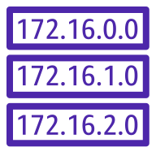
Region (us-west-2)
us-west-2a
us-west-2b
Internet Gateway
VPC (regional, spans AZs)
Route Table
Private subnet
(tied to us-west-2b)
Public subnet
(tied to us-west-2a)
SUBNET CIDR RANGE 10.0.0.0/24
SUBNET CIDR RANGE
10.0.1.0/24
VPC CIDR BLOCK: 10.0.0.0/16
Notes:
So here’s what we have right now—two subnets in our VPC. And we called the one on the left a public subnet, but again, the only way to make (click) it public is to hook it up to the internet gateway, by defining a route in the route table.

Slide 54
VPC
Main Route Table
Public subnet
Private subnet
Notes:
Now, just a brief word here about route tables. When you create a VPC, AWS automatically creates a default route table called the main route table, and it associates it with every subnet in that VPC.
If we were to go out to the Console now (do this) and look at Route tables (left nav), filter by our VPC, you’ll see that we have a route table, and if we look at Subnet associations, we have TWO without explicit associations. And the note there saying that if they aren’t explicitly associated with some other route table, then they’re defaulted to being associated with this one. So that’s what happens when you create the VPC—just happens automatically.
But we can create our own custom route tables and associate the subnets with those, which we’ll do in a minute. But let me just quickly touch on one more concept for route tables.

Slide 55
The Default Route to Enable Internet Access
DESTINATION | TARGET | WHAT THIS MEANS
10.0.0.0/16 | Local | If you see a request to an IP address inside of our VPC’s CIDR block, route it locally within the VPC
Local Route
Notes:
…and that is the default route. When we get to the demo in a second, you’ll see that we have a local route, so saying destination 10.0.0.0/16, target local. And this means hey, if you see a request to an IP address inside of our VPC’s CIDR block—that /16 there--route it locally within the VPC. This is private traffic that should only be in our VPC. This is called (click) the local route.

Slide 56
The Default Route to Enable Internet Access
DESTINATION | TARGET | WHAT THIS MEANS
10.0.0.0/16 | Local | If you see a request to an IP address inside of our VPC’s CIDR block, route it locally within the VPC
0.0.0.0/0 | Internet Gateway | If it’s any other IP (other than the ones listed above), route it to the Internet Gateway
Local Route
Default Route
Notes:
If you want to enable internet access, making this a public subnet, you need this (click) default route, where the destination is 0.0.0.0/0, target the internet gateway. This says iof it’s any other IP (other than the ones listed above), route it to the Internet Gateway.

Slide 57
DEMO
Creating an Internet Gateway and Routing to It
Notes:
m6-09 = “DEMO: Creating an Internet Gateway and Routing to It”
Coming up in this demo, we’ll create an Internet Gateway and associate it with our VPC. Then we’ll create two custom route tables, associate our subnets with them. And then from our one subnet that we want to be public, we’ll create a route from the subnet to the internet gateway so we can reach the internet.
To next slide

Slide 58
Region (us-west-2)
us-west-2a
us-west-2b
Internet Gateway
VPC (regional, spans AZs)
Route Table
Route Table
Public subnet
(tied to us-west-2a)
Private subnet
(tied to us-west-2b)
SUBNET CIDR RANGE 10.0.0.0/24
SUBNET CIDR RANGE
10.0.1.0/24
VPC CIDR BLOCK: 10.0.0.0/16
Notes:
So basically this. We’ll create (click) two custom route tables, but then for the one tied to the public subnet, we’ll create a route out to the internet gateway. We’ll also (click) create an EC2 instance inside the public subnet to illustrate that it can send and receive internet traffic.
Back to demo (next slide)

Slide 59
Region (us-west-2)
us-west-2a
us-west-2b
VPC (regional, spans AZs)
Public subnet
(tied to us-west-2a)
Private subnet
(tied to us-west-2b)
SUBNET CIDR RANGE 10.0.0.0/24
SUBNET CIDR RANGE
10.0.1.0/24
VPC CIDR BLOCK: 10.0.0.0/16
Notes:
So here’s what we have right now. We have an instance in the subnet that we’re calling public, but it’s not actually public yet because we don’t have the internet gateway or routes out to it. So let’s create the internet gateway next.

Slide 60
Region (us-west-2)
us-west-2a
us-west-2b
Internet Gateway
VPC (regional, spans AZs)
Public subnet
(tied to us-west-2a)
Private subnet
(tied to us-west-2b)
SUBNET CIDR RANGE 10.0.0.0/24
SUBNET CIDR RANGE
10.0.1.0/24
VPC CIDR BLOCK: 10.0.0.0/16
Notes:
Okay! Now we have an internet gateway. And you might be tempted to try to connect to our EC2 instance again, but would it work? No, because again, just because we have an internet gateway doesn’t mean we automatically get out to the internet. We need to route to the internet gateway first. And to do that, we’ll need some route tables.

Slide 61
Region (us-west-2)
us-west-2a
us-west-2b
Internet Gateway
VPC (regional, spans AZs)
Route Table
Route Table
Public subnet
(tied to us-west-2a)
Private subnet
(tied to us-west-2b)
SUBNET CIDR RANGE 10.0.0.0/24
SUBNET CIDR RANGE
10.0.1.0/24
VPC CIDR BLOCK: 10.0.0.0/16
Notes:
So here’s what we have now. And once again, you might be tempted to go try connecting to that EC2 instance again, but once again, it will still fail because we need to add the actual route TO the route table that allows us to get to the internet gateway. So we’re almost there!

Slide 62
Region (us-west-2)
us-west-2a
us-west-2b
Internet Gateway
VPC (regional, spans AZs)
Route Table
Route Table
Public subnet
(tied to us-west-2a)
Private subnet
(tied to us-west-2b)
SUBNET CIDR RANGE 10.0.0.0/24
SUBNET CIDR RANGE
10.0.1.0/24
VPC CIDR BLOCK: 10.0.0.0/16
Notes:
So there’s that final connecting piece that should allow our EC2 instance to send and receive traffic on the internet. Let’s go try it.
Go back to instance, connect with EC2 Connect. Should work, so we can get TO it from the internet.
Then ping www.amazon.com – should work. So we can get OUT to the internet from the instance as well.
So there you go! We have our own VPC with a private and public subnet, and the public subnet is hooked up to the internet now. Nicely done!

Slide 63

Elastic Network Interface (ENI)
Used by an EC2 instance to communicate with other network resources (AWS, on-premises, Internet, etc.)
Think of it as a virtual networking card
Every instance has a primary ENI
Connected to only one subnet, and cannot be removed
Can attach additional ENIs
Can be created independently of an instance and attached at a later point
Can be moved to another instance to support failover
Notes:
m6-10 = “Elastic Network Interfaces (ENI) Overview”
So far in this module, we’ve talked a lot about making connections between instances and internet gateways and subnets and a bunch of other things. But backing up just a little bit, what even makes that possible? What allows an EC2 instance to communicate over the network?
It’s something called an Elastic Network Interface, or ENI. This allows an EC2 instance to communicate with other network resources, whether those are other AWS resources, a server on-premises, the Internet or what have you. You can KIND Of think of it as a virtual networking card.
Every EC2 instance will have a primary ENI. And if we were to look at any of the instances we’ve been working with so far, they do. It’s just happening automatically for you. But you can also attach additional ENIs too. Maybe you want a secondary IP address, for example.
You can create ENIs independently of an instance, and then attach it at a later point.
You can also move an ENI from one instance to another. A good use case for this is failover, where maybe you have a web server that has a secondary ENI on it. If that server goes down, you can move that secondary ENI to another instance and effectively assign it that IP, and you can carry on using that same IP address.

Slide 64
DEMO
Working with Elastic Network Interfaces (ENIs)
Notes:
m6-11 = “Working with Elastic Network Interfaces (ENIs)”
SETUP: Have two EC2 instances running in the same VPC and public subnet (public-eni-demo-1 and public-eni-demo-2)
In this demo, we’ll go create a network interface and see how we can move it between instances.
Here you’ll see I have two instances, and they’re both running in the same subnet.
If we look at public-eni-demo-1, under Networking, you’ll see that the ENI has a public IPv4 address and a private IPv4 address. And you’ll see it’s attached. public-eni-demo-2 will have the same thing. So these are the primary ENIs for these instances.
If we go to Network Interfaces (left nav), I have quite a few here for other things I’ve been doing, but if we scroll down, we’ll find the two for my instances, and I can see the public and private IP addresses there.
So let’s create another network interface and attach it as a secondary ENI to one of our instances, then we’ll see that we can move it.
Create network interface
Subnet: Should be in the same subnet as our instances—PublicSubnetA
Security group: Default
Create
Now in our list of network interfaces, notice that this one is showing as Available. So we can attach it to an instance.
Attach it to public-eni-demo-1
Now look at this instance, Networking, show that it has two ENIs now, and two private IPv4 addresses. Now say that this instance goes down, and you want to take that second private IP address and attach it to a new instance for failover.
Then detach (force detach…might take a minute to show as Available again, and probably have to refresh entire page so Action menu refreshes) and attach it to my-public-instance-2
Back to instances, show that my-public-instance-2 has two IPs now.
Now, one thing to note, when you terminate these instances (do now), the primary ENIs that were attached when they were created, those will get deleted automatically. But this ENI that we just created manually, that won’t get deleted. So let’s go delete that now.

Slide 65

SECURITY GROUPS
Notes:
m6-12 = “Security Groups Overview”
We’ve been using security groups in various places throughout the course—whether when we create a new EC2 instance, or when we were allowing our load balancer to access containers in the Elastic Container Service. And at this point, you should be familiar with the basic concepts, but let’s dig a little deeper.

Slide 66
Security Groups
To be precise, controls traffic on the instance’s ENI
Security Group
Rules that control inbound and outbound traffic
EC2 Instance
Notes:
A security group is effectively a firewall that sits around your EC2 instance. (click) So we have our EC2 instance, and the security group (click) sits around it, and by the rules that we define (click), it controls inbound and outbound traffic to and from the instance.
Or to be even more precise (click), it controls traffic to the instance’s ENI, or elastic network interface.

Slide 67


By default, all inbound traffic is denied
Security Group
Rules that control inbound and outbound traffic
EC2 Instance
Notes:
So for example, if someone were to try to hit an EC2 instance from their browser, maybe trying to get to a website that’s hosted on the server (click), by default, they would be denied. So that’s an important point; inbound traffic is all denied. You have to create an inbound rule to allow it.

Slide 68
Inbound: HTTP traffic on Port 80 from anywhere
Security Group
Rules that control inbound and outbound traffic
EC2 Instance
Notes:
So we’d need to create an inbound rule that says HTTP traffic is allowed over Port 80 from anywhere. So that will allow our user to hit the website.

Slide 69
Security Group
Rules that control inbound and outbound traffic
EC2 Instance
By default, all outbound traffic is allowed
Notes:
And then outbound traffic, by default, all traffic is allowed. So this server could send back a web page with images or whatever the response is without any issues.

Slide 70
Inbound Rules
SOURCE | PROTOCOL | PORT RANGE | WHAT THIS MEANS
198.51.200.01/32 | TCP | 22 | Inbound traffic is allowed on Port 22 (SSH), but only if it’s coming from the IP address 198.51.200.01
Notes:
Let’s go through a couple of examples. Every inbound rule will have a source, protocol and a port range.
For this one, the source is a specific IP 198.51.200.01/32. Remember that /32 means it’s just a single IP address. Protocol is TCP, and port is 22, which is the port for SSH.
So this rule is saying Inbound traffic is allowed on Port 22 (SSH), but only if it’s coming from the IP address 198.51.200.01.

Slide 71
Inbound Rules
SOURCE | PROTOCOL | PORT RANGE | WHAT THIS MEANS
198.51.200.01/32 | TCP | 22 | Inbound traffic is allowed on Port 22 (SSH), but only if it’s coming from the IP address 198.51.200.01
0.0.0.0/0 | TCP | 80 | Inbound traffic is allowed on Port 80 (HTTP) from any IP address (Internet and in the VPC)
Notes:
This second rule, is saying Inbound traffic is allowed on Port 80 (HTTP) from any IP address (Internet and in the VPC). That 0.0.0.0/0 means any IP.

Slide 72
Outbound Rules
DESTINATION | PROTOCOL | PORT RANGE | WHAT THIS MEANS
0.0.0.0/0 | All | All | Outbound traffic allowed to everywhere (the Internet and other AWS resources)
Notes:
And then on outbound rules, this rule is actually automatically created for you when you create a security group. And this is saying Outbound traffic allowed to everywhere (the Internet and other AWS resources).

Slide 73
Other Notes About Security Groups
Specific to a region and VPC
If you don’t see a security group, it might be in a different region
Source and destination can be a CIDR or another security group
Stateful
When traffic is allowed in one direction, the security group allows reply traffic in the opposite direction
Default security group
Automatically created for each VPC
You cannot delete it, but you can modify it to meet your needs
Notes:
A few other things to note about security groups.
Specific to a region and VPC
If you don’t see a security group, it might be in a different region
Source and destination can be a CIDR (like we’ve seen) or another security group
If you watched the Elastic Container Service demo, you might remember that our security group around our containers allowed traffic coming from the security group around the load balancer. So you can allow things from one security group to another.
Stateful
When traffic is allowed in one direction, the security group allows reply traffic in the opposite direction. Like an HTTP request, for example.
Default security group
Automatically created for each VPC
You cannot delete it, but you can modify it to meet your needs

Slide 74
DEMO
Creating a Custom Security Group
Notes:
m6-13 = “DEMO: Creating a Custom Security Group”
EC2→Security groups
You can also get here under VPC since this is technically a networking security feature.
Create security group
Name: MyCustomSecurityGroup
Description: Allows HTTP/HTTPS access from anywhere, SSH from my IP
Just a note that it’s common to use a dedicated security group for SSH access, just so it’s easier to manage it, but for this demo, we’re going to include these three rules together.
VPC: Use the one we created earlier (my-first-vpc)
Note that there’s already a rule there for outbound traffic to anywhere. And this was created automatically when we created the security group. But the inbound rules are the ones we’re concerned with here.
Add rule:
HTTP, 80, anywhere
HTTPS, 443, anywhere
SSH, 22, My IP
Create
Now once that’s created, when you go to create a new EC2 instance (start this), you can Select existing security group (but note that it’s not there…gotcha!). Make sure you Edit networking settings, you’re in the right VPC, my-first-vpc.
So there you have it. That’s how to create a new security group from scratch, but you can also edit an existing one (select an existing one→inbound rules→edit inbound rules) using similar steps.

Slide 75
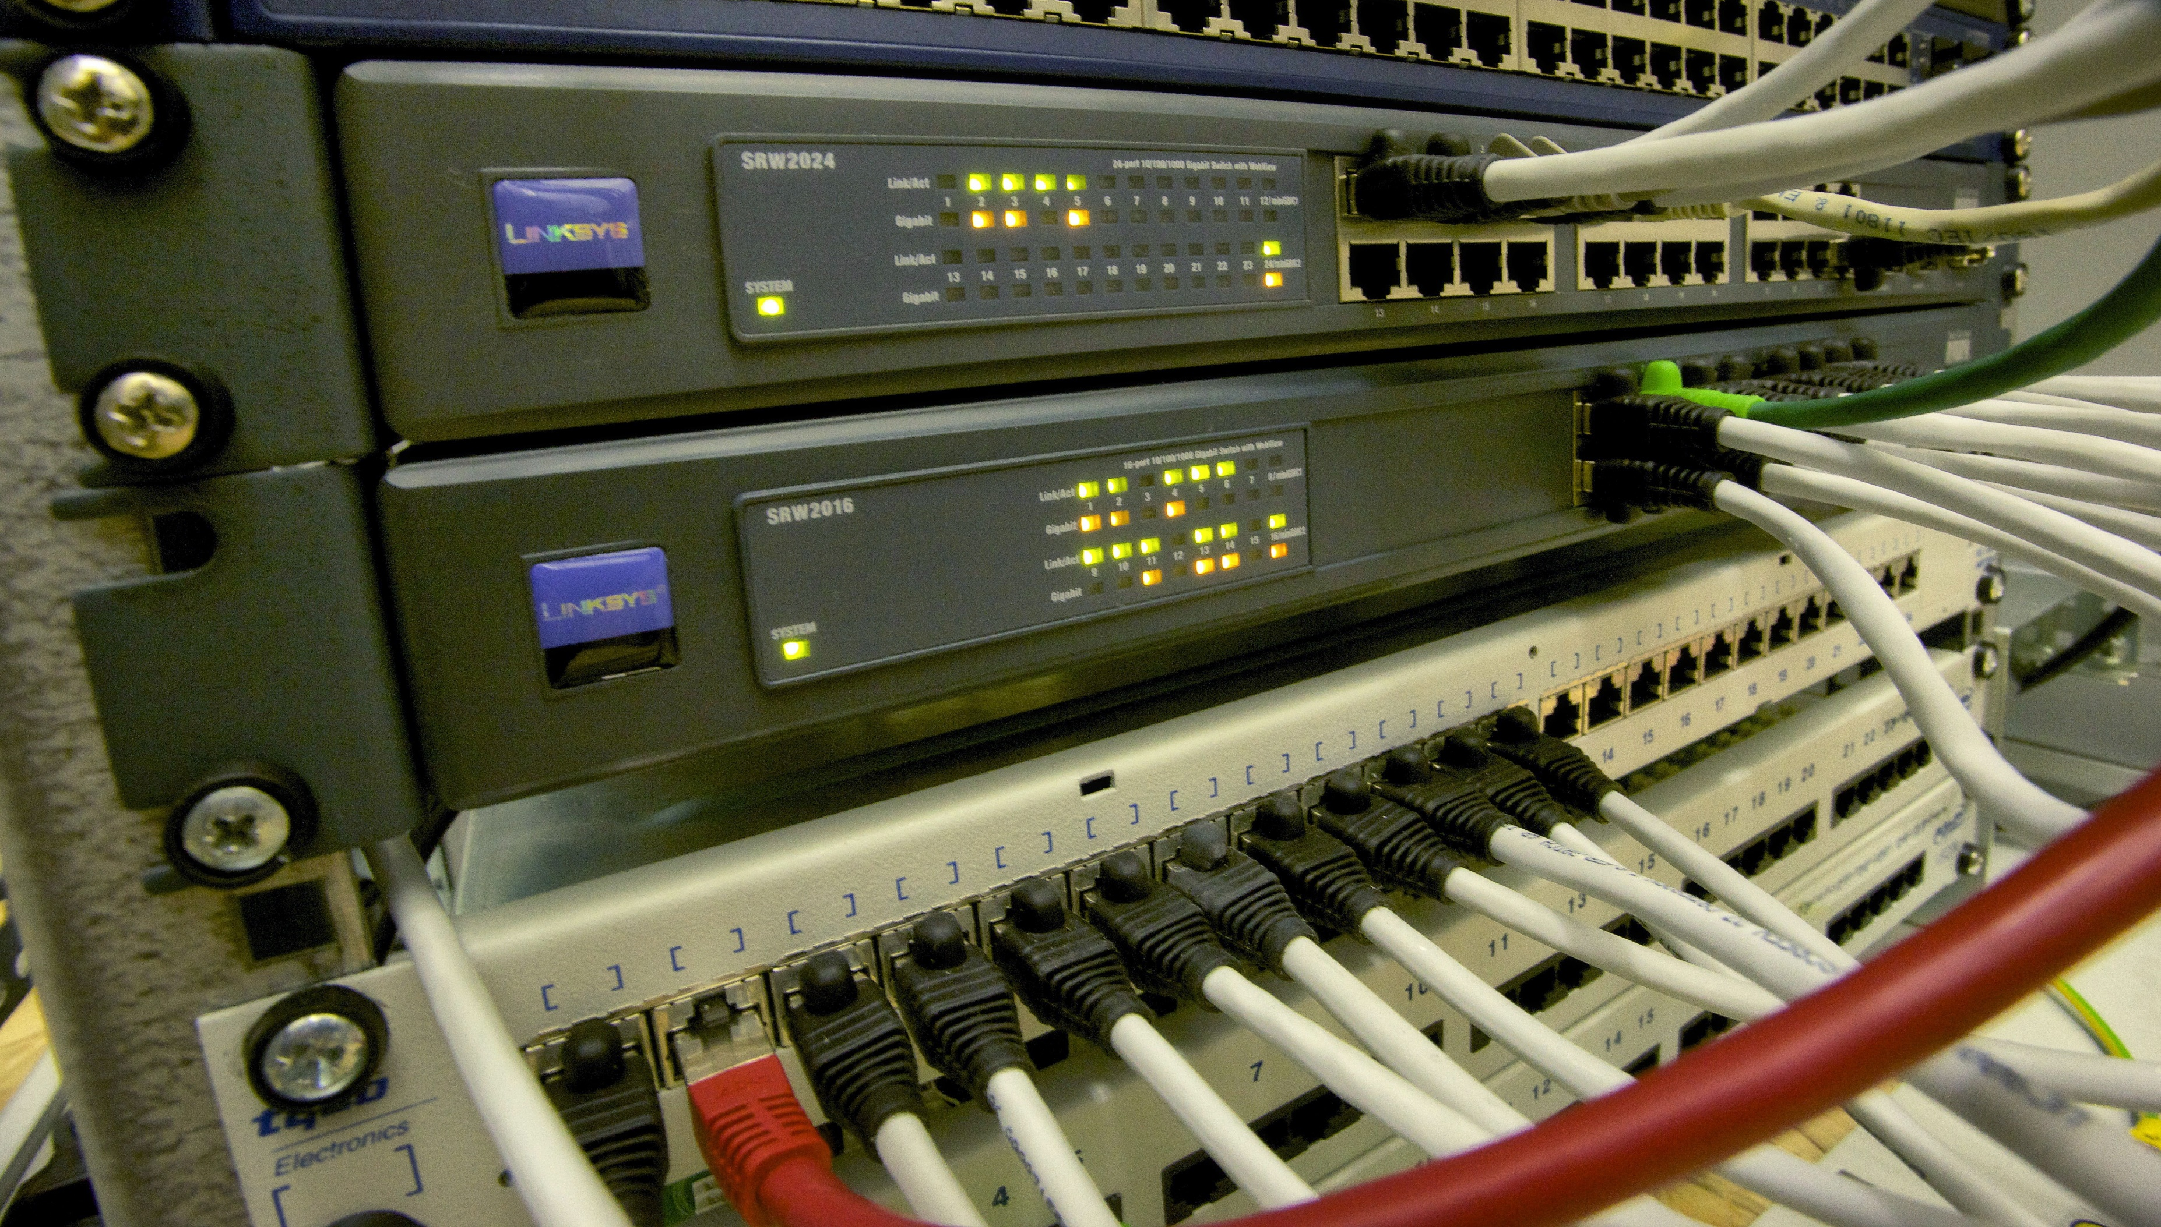
NETWORK ACCESS CONTROL LISTS (NACLs)
Notes:
m6-14 = “Network Access Control Lists (NACLs) Overview”
Now let’s move on to talking about another way to secure your network, and that’s with network access control lists, or NACLs.

Slide 76

Network Access Control List (NACL)
NACL
Subnet
Rules that control inbound and outbound traffic
Notes:
Similar to a security group, a network access control list is effectively a firewall that controls inbound and outbound traffic. But rather than doing that at the instance level, the NACL sits at the subnet level. So it’s adding another layer of security beyond what you get with security groups.

Slide 77
Network Access Control List (NACL)
One NACL per subnet
But one NACL can be associated with multiple subnets
NACL
Subnet
Rules that control inbound and outbound traffic
Notes:
You can have one NACL per subnet. But one NACL can be associated with multiple subnets. So maybe you have multiple subnets set up for a web tier, and you want the same rules on all of them. You can create just one NACL and apply it to all of those subnets.

Slide 78
NACL Rules
Rules evaluated by number
Lowest number evaluated first
RULE NUMBER | PROTOCOL | PORT RANGE | SOURCE | ACTION | WHAT THIS MEANS
100 | All | All | 0.0.0.0/0 | Allow | Allows all traffic from any source
* | All | All | 0.0.0.0/0 | Deny | Denies all traffic, but because everything was “caught” in Rule 100, has no effect in this example
The default rule designated with *; can’t be deleted
Always evaluated last, and “catches” anything that didn’t match prior rules
Notes:
NACLs have inbound and outbound rules that control traffic, and I’m showing a couple of examples here.
(click) Each rule has a number associated with it, and that controls the order in which they’re evaluated. The lowest number is evaluated first. So if we had rules for 100, 200 and 300, 100 would be evaluated first, 200 second and so on.
And then every NACL will have what’s called the default rule, which is designated with the asterisk like you see here. This default rule can’t be deleted. This one will always be evaluated last, and basically says, any traffic coming in (or out) that wasn’t caught by a previous rule, deny it.

Slide 79
The Default NACL
This defines the Default NACL, which allows everything
(Rules the same for Inbound and Outbound)
RULE NUMBER | PROTOCOL | PORT RANGE | SOURCE | ACTION | WHAT THIS MEANS
100 | All | All | 0.0.0.0/0 | Allow | Allows all traffic from any source
* | All | All | 0.0.0.0/0 | Deny | Denies all traffic, but because everything was “caught” in Rule 100, has no effect in this example
When a subnet is created, the Default NACL is associated with it automatically
Can modify the Default NACL, but it’s better is to create your own NACLs
Notes:
And then this set of two rules that I’ve shown here, this is known as the Default NACL. And it allows all traffic. Which makes sense because if it didn’t, when you go to create your first EC2 instance in AWS, for example, nothing would work because traffic couldn’t get in or out.
When you create a new subnet (click), the Default NACL is associated with it automatically---so these two rules we see here. You CAN modify the Default NACL, but a best practice is to create your own NACLs for whatever your needs are.

Slide 80
Example: How to Block HTTP Traffic on Port 80?
RULE NUMBER | PROTOCOL | PORT RANGE | SOURCE | ACTION | WHAT THIS MEANS
100 | All | All | 0.0.0.0/0 | Allow | Allows all traffic from any source
* | All | All | 0.0.0.0/0 | Deny | Denies all traffic, but because everything was “caught” in Rule 100, has no effect in this example
Notes:
So let’s build on that concept and talk through an example. Say you want to block HTTP traffic on Port 80 from your subnet. How would you modify this rule?
Well, because the rules are evaluated from lowest number to highest, you’d (click) need to insert something with a number less than 100, so insert at the top here. And actually, the position in the “table” doesn’t matter, but you WILL need a number lower than 100.

Slide 81
Example: How to Block HTTP Traffic on Port 80?
INBOUND
RULE NUMBER | PROTOCOL | PORT RANGE | SOURCE | ACTION | WHAT THIS MEANS
90 | TCP | 80 | 0.0.0.0/0 | Deny | Blocks all traffic with a destination of Port 80
100 | All | All | 0.0.0.0/0 | Allow | Allows all traffic other than that destined to Port 80
* | All | All | 0.0.0.0/0 | Deny | Denies everything else (again, no effect in this example)
Notes:
And here we’d (click) be talking about inbound rules. And for the (click) rule number, I’m arbitrarily saying 90, but really anything less than 100. And then we say protocol of TCP, port range 80, from anywhere, is denied.
And then (click, click) the subsequent rules, Rule 100 says, okay, any traffic that’s destined to a port other than 80—because that was caught in the first rule—we’re going to allow that.
And then the default rule on the bottom, this denies everything else, but again in this example, it won’t have an effect because Rule 100 would have caught everything and allowed it.

Slide 82
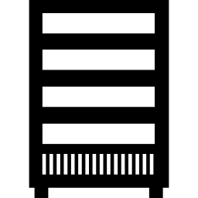
Ephemeral Ports
HTTP
Port 80
Client
Server
No defined port for response
Notes:
Now let’s talk about the concept of ephemeral ports. Boiling things down to the simplest form, we have a client that sends a request to a server, and then the server will send back a response. Pretty basic stuff.
And just sticking with an example of HTTP requests (click), the client will send an HTTP request to Port 80, which is a fixed or defined port for that kind of traffic. And the server will be listening on that port. But the client (click) doesn’t have a defined port to listen to the response. IT isn’t listening on Port 80, for example, for responses.

Slide 83
Ephemeral Ports
HTTP
Port 80
Client
Server
Opens an ephemeral port that’s active for the life of the connection (e.g., 38406)
Port ranges vary by operating system
Linux: 32768-61000
Windows (later versions): 49152-65535
Notes:
So it opens up what’s called an ephemeral port—ephemeral meaning short-lived, not permanent—and it’s active for just the life of this connection. Let’s say it opens up port 38406, and that’s where it’s going to listen for a response back from this request that it made to the server. That port number is chosen by the client, and
Now, these port ranges vary (click), but here are the ranges for Linux and later versions of Windows. There are also ranges for things like load balancers and NAT gateways and such, if your request isn’t coming directly from another server, and those start at port 1024. So fairly big ranges to cover all possibilities.

Slide 84
Ephemeral Ports and NACLs
HTTP
Port 80
Client
Server
Opens an ephemeral port that’s active for the life of the connection (e.g., 38406)
NACL must allow traffic out of the subnet on the possible range of ephemeral ports (e.g., 1024-65535 to cover the different types of clients)
Notes:
What this means for NACLs is that your NACL needs to allow traffic back OUT so it can respond to the client on the ephemeral port that it’s using. In practical usage, a range like 1024-65535 will cover the different types of clients that might initiate requests, whether that’s Windows, Linux, a load balancer, etc.
We’ll go through another example in a minute, but just a few other notes about NACLs…

Slide 85
Other Notes About NACLs
Common use case: block traffic from a specific IP address (not possible with a security group)
Stateless
When traffic is allowed in one direction, the return direction is NOT automatically allowed (unlike with stateFUL security groups)
Must explicitly permit return traffic
New NACLs will automatically deny everything
vs. the Default NACL, which allows everything
Notes:
A few other things to note about NACLs.
A really common use case for NACLs is to deny or block traffic from a specific IP address. With security groups, you can only ALLOW things, not deny. But you get deny with NACLs, and that’s a common reason to use them.
NACLs are stateless, meaning that when traffic is allowed in one direction, the return direction is NOT automatically allowed. This is different than stateful security groups. With NACLs, you have to explicitly permit the return traffic, so inbound AND outbound rules.
And if you go and create a NEW NACL, it will automatically deny everything. This is in contrast to the Default NACL, which allows everything by default.

Slide 86
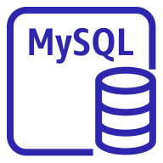
Another Example
OUTBOUND
Allow TPC, Port 3306, to Database Subnet CIDR
NACL
NACL
Web Subnet (Public)
Database Subnet (Public)
INBOUND
Allow TPC, Port 3306, from Web Subnet CIDR
EC2 Instance
(Ephemeral Port)
OUTBOUND
Allow TPC, Ports 1024-65535, to Web Subnet CIDR
MySQL Instance (Port 3306)
INBOUND
Allow TPC, Ports 1024-65535, from Database Subnet CIDR
Notes:
So let’s go through another example where we have resources in two different subnets that need to talk to each other. We have a web subnet that’s public so we can receive traffic in. And then a common setup is to have a private subnet where you place your databases. The EC2 instance on the left will be using an ephemeral port, and the MySQL instance on the right uses Port 3306. And then (click) each subnet is going to be protected with a NACL.
On the web subnet (click), your NACL will need an outbound rule, allowing TCP traffic, Port 3306 to the database subnet CIDR. And then on the database subnet (click), that NACL will need to allow traffic in, TCP, Port 3306, and specifically the traffic coming from the web subnet CIDR.
Then going (click) back the other direction—remember, NACLs are stateLESS, so the return traffic doesn’t just automatically get allowed. We need to say outbound TCP traffic is allowed, ports 1024-65535—that big range to make sure we’re covering all possible ephemeral ports from the various devices. And here, the traffic is going TO the web subnet CIDR.
And then finally, on the web subnet NACL, we need an inbound rule to allow that traffic on ports 1024-65535 from the database subnet CIDR.
So as you can see, you need to be very specific and careful about setting up the NACLs to get them just right.

Slide 87
DEMO
Working with Network Access Control Lists (NACLs)
Notes:
m6-15 = “DEMO: Working with Network Access Control Lists (NACLs)”
In this demo, we’ll take a look at how to modify rules on our NACL and then see the effect it has with being able to connect to instances.
VPC→Network ACLs
When we created these subnets (2), the Default NACL was automatically associated with them. And you’ll remember the rules that you’ll find in the default (show inbound and outbound), allowing all traffic.
If we go find our instance that lives in the PublicSubnet2 (should be my-public-instance), we should be able to SSH into it, no problem, because traffic is allowed on Port 22 and all other ports through the NACL. AND traffic is allowed on Port 22 through the security group too (show this) so the two different layers. But here we’re working with the NACL. Connect via Instance Connect, and this works just fine.
Edit NACL inbound rules (add new one)
Rule #: 90
Type: SSH
Source: 0.0.0.0/0
Deny
Save
Updates happen pretty instantaneously, so no need to wait for things to propagate.
Show that connection in Instance Connect no longer working (will freeze). If you refresh, it will try to re-establish the connection, you’ll see you get an error. And remember, the security group still says that SSH will work, but the NACL sits outside of that, at the subnet level, and we’re getting denied there.
Now, just to reiterate the importance of the order of the rules, if we change our rule from #90 to, say, #110 (do this), then rule 100 will allow all traffic, so there’s nothing left by the time we get to rule 110, and so SSH won’t be denied. I should be able to SSH in again (show this in Instance Connect).
Delete the new rule (now 110)

Slide 88
Network ACLs and Security Groups
NETWORK ACLs
SECURITY GROUPS
Firewall that controls traffic in/out of a subnet
Rules for Allow and Deny
Rules include IP addresses/ CIDRs (only)
Stateless (return traffic must be explicitly allowed)
Firewall that controls traffic in/out of an EC2 instance
Rules for Allow (only)
Rules include IP addresses/ CIDRs AND other security groups
Stateful (return traffic automatically allowed)
VPC
VPC
Public subnet
Public subnet
NACL
Security Group
Notes:
m6-16 = “Network Access Control Lists (NACLs) vs. Security Groups”
Okay, now that we understand more of the details of NACLs and security groups, I wanted to do a quick comparison slide between the two because seeing them side-by-side I think helps. And these concepts can definitely come up on the exam.
A (click) network ACL is a firewall that controls traffic in and out of a subnet, (click) and it’s attached to the subnet. So you’ll see that there in the diagram. It has (click) rules for allow and deny, and we said a common use case is to deny traffic from a particular IP address, say a known hacker.
The rules can include IP addresses/CIDRs only. In other words, you can’t allow or deny traffic from another NACL.
And these are stateless, meaning return traffic must be explicitly allowed. If you have an inbound rule, you’ll need to create a corresponding outbound rule for the full connection to work.
And then for Security groups (click), this is a firewall that controls traffic in and out of an EC2 instance, so down a level (click), as you’ll see in the diagram. Here, you can (click) only make rules for Allow—so allow traffic from other AWS resources, for example. And here you can include IP addresses/CIDRs AND other security groups.
And security groups are stateful, meaning return traffic is automatically allowed. If we allowed traffic IN on Port 80, then traffic OUT on Port 80 is automatically okay.
So these are the key differences. If you get questions on the exam about security a subnet, then think network ACL. And if you get questions about securing an instance, then think security group.

Slide 89
Network Address Translation (NAT)
198.60.240.48
Internet Gateway
VPC
Public subnet
Private subnet
EC2 Instance
Notes:
m6-17 = “Network Address Translation (NAT) Overview”
Now let’s talk about network address translation, or NAT.
Say you need to do something like this. You have an instance in a public subnet (click), and it needs to talk to this server on the internet.

Slide 90
Network Address Translation (NAT)
198.60.240.48
Internet Gateway
VPC
Public subnet
Private subnet
ENI
EIP: 40.168.236.26
Associate an Elastic IP with the ENI
EC2 Instance
Private IP: 172.31.6.02
Notes:
We know this instance has a private IP. Or more specifically, it has an (click) ENI—Elastic Network Interface—that has a private IP. And we say we’re going to need a public IP so we can talk to the outside world and they can talk to us back.
You might remember that an ENI can have multiple PRIVATE IP addresses. But for public, how this works is (click), we’re going to associate an Elastic IP with the ENI like shown here, 40.168.236.26. And as we learned earlier, an Elastic IP is a public fixed or static IP that won’t change. But when we try to connect to the outside world…

Slide 91
Network Address Translation (NAT)
The translation happens at the Internet Gateway
198.60.240.48
Internet Gateway
VPC
Public subnet
Private subnet
ENI
EIP: 40.168.236.26
EC2 Instance
Private IP: 172.31.6.02
Notes:
…the translation happens at the internet gateway. And that’s what we mean by network address translation, or NAT. It’s where the internet gateway maps a public IP address to the ENI’s private IP address so communication can happen with the outside world.

Slide 92
Network Address Translation (NAT)
198.60.240.48
SOURCE: 40.168.236.26
DESTINATION: 198.60.240.48
Internet Gateway
VPC
SOURCE: 172.31.6.02
DESTINATION: 40.168.236.26
Public subnet
Private subnet
ENI
EIP: 40.168.236.26
EC2 Instance
Private IP: 172.31.6.02
Notes:
Let’s go through an example that I think will help.
So our instance wants to talk to the outside world. It makes a request that goes to the Internet Gateway. (click) We say the source—the IP we’re coming from—is the private IP, 172.31.6.02, and the destination is NOT the ultimate service out on the Internet, but it’s this Elastic IP, EIP: 40.168.236.26.
The internet gateway then does (click) the translation and passes the request on to the actual server on the Internet. And here, it’s saying that the source is the public Elastic IP—not the private—and that the destination is the 198.60.240.48, the server on the Internet.

Slide 93
Network Address Translation (NAT)
198.60.240.48
SOURCE: 40.168.236.26
DESTINATION: 198.60.240.48
Internet Gateway
VPC
SOURCE: 172.31.6.02
DESTINATION: 40.168.236.26
Public subnet
Private subnet
ENI
EIP: 40.168.236.26
EC2 Instance
Private IP: 172.31.6.02
Notes:
When the instance makes the request, it’s always coming from the private IP (click) as the source, but then the internet gateway is effectively rewriting the packet and making it look like it’s (click) coming from the public IP.
And going back the other direction, the reverse would happen, with the internet gateway doing the translation between public and private.

Slide 94
Network Address Translation (NAT) Devices
In addition to network address translation in the Internet Gateway, two other resources can perform this function
1: NAT Gateways and 2: NAT Instances
NAT devices allow instances WITHOUT PUBLIC IPs to get out to the internet, but prevents traffic in
Internet Gateway handles translation for instances WITH PUBLIC IPs
Common use case: doing patching, updates or uploading data
Notes:
m6-18 = “Network Address Translation (NAT) Devices”
So we’ve covered the basics of network address translation that happens at the internet gateway, but there are two other resources in AWS that can perform this function as well.
Those are NAT Gateways and NAT instances, and we’ll hit on each in more detail here in a second.
But the whole reason for NAT devices to exist is that they allow instances that DON’T have public IPs to get out to the Internet, without letting traffic back IN. And just to make the distinction clear, with the Internet Gateway NAT functionality, that handles translation for instances that DO have public IPs.
Some common use cases here would be doing patching or updates or uploading data. So no reason for the outside world to initiate a connection with you, but you do occasionally need to get out to do something.

Slide 95
Network Address Translation (NAT) Devices
1: NAT Gateway
Recommended approach
Managed by AWS and scales automatically to accommodate bandwidth requirements
Must live in a public subnet
Does not have an ENI, so security groups do not apply (use NACLs on the subnet)
Requires an Internet Gateway
Routes required from private subnet to NAT Gateway to Internet Gateway
Is tied to a single Availability Zone; for redundancy, create additional NAT Gateways in other AZs
Notes:
So the first device is the NAT Gateway. This is the recommended approach these days. This is a managed service that will scale automatically to accommodate bandwidth requirements.
It has to live in a public subnet.
The NAT Gateway itself doesn’t have an ENI attached to it, so security groups don’t apply here. But you can still secure it by using Network ACLs at the subnet level.
This does also require an Internet Gateway. So just a NAT Gateway by itself won’t get you to the internet. You need an Internet Gateway and then routes from the private subnet to the NAT Gateway and then to the Internet Gateway. We’ll see a diagram here in a second.
And lastly, a NAT Gateway is tied to just a single Availability Zone, so by default, not highly available. For redundancy, you’ll want to create additional NAT Gateways in other AZs.

Slide 96

Region
Availability Zone 1
Availability Zone 2
Internet Gateway
VPC (regional, spans AZs)
Public subnet
(tied to AZ, accessible from internet)
Public subnet
(tied to AZ, accessible from internet)
NAT Gateway
Private subnet
(tied to AZ, NOT accessible from internet)
Private subnet
(tied to AZ, NOT accessible from internet)
Notes:
So a scenario like this. You have an instance (click) in a private subnet that needs to get out to the internet to retrieve some updates, let’s say. You don’t want the outside world getting in, but YOU need to get out for certain things.
That’s where the NAT Gateway comes in. You have a public subnet up there on top, and we know it’s public because it has a route to the Internet Gateway already.
You’d create the NAT Gateway IN that public subnet, (click) add a route from your private instance to it, and then add (click) a route from the NAT Gateway to the Internet Gateway.
And this is how you enable internet access for your resources in a private subnet.

Slide 97
Network Address Translation (NAT) Devices
2: NAT Instance
Older technology, support discontinued at the end of 2020
A preconfigured Linux-based AMI (i.e., a “regular” EC2 instance)
Has an ENI
Must assign it a public IP address
Must use a security group with it
Does not automatically scale
Must disable source/destination check so it can receive traffic addressed to an IP other than its own
Notes:
The second type of NAT device is the NAT instance. This is an older technology, and support for it officially ended at the end of 2020, but just in case it comes up on the exam, I wanted to cover the basics here.
This is a preconfigured Linux-based AMI—in other words, a “regular” EC2 instance that you’d spin up like any others, and it’s going to do the translation we’ve been talking about, between private IPs and public. This one DOES have an ENI, which means you need to assign it a public IP address, and you also have to set up a security group for it.
This one DOESN’T scale automatically, so you’ll need to monitor how things are going and potentially bump up or down the size of the instance.
And there’s something called a source/destination check that you’ll need to disable so that it can receive traffic that’s addressed to an IP address other than its own.
On the exam, if you get questions about using NAT instances or NAT gateways, the answer will almost certainly be NAT gateways as, again, these are on the way out and not supported anymore.

Slide 98

BASTION (“JUMP”) HOSTS
Notes:
m6-19 = “Bastion Hosts Overview”
Let’s talk about our next concept of a bastion host, sometimes called a jump host, and you’ll understand why here shortly.

Slide 99
Bastion Host
How to SSH?
VPC
Public subnet
Private subnet
EC2 Instance
Notes:
Here’s the scenario. We have an EC2 instance in a private subnet, and we need to SSH into it. How do you do that?
You can’t connect that instance, or that subnet, to an internet gateway and open it up that way because that would basically make the subnet a public subnet. And the whole point of having a private subnet is to keep it private, to make it inaccessible from the internet.

Slide 100
Bastion Host
SSH
VPC
Public subnet
Private subnet
BASTION: “A projecting part of a fortification”
EC2 Instance – Bastion Host
EC2 Instance
Notes:
So what you need to do is create an EC2 instance in the public subnet—this is your bastion host—and from that host, then make a jump or a hop over to the private subnet. That’s why this is sometimes called a “jump host” sometimes…you’re jumping through the bastion host to get to the other host.
And if you’re not familiar with (click) the term bastion, it’s a projecting part of a fortification. In the physical world, historically, this was usually a wall around a fort or a castle that protected you from enemies. So kind of the same idea here, that it’s protecting your private instance from the outside world.

Slide 101
Bastion Host
SSH
VPC
Public subnet
Private subnet
Security Group (“BastionSG”)
allows traffic on Port 22 (only) for SSH
EC2 Instance – Bastion Host
EC2 Instance
Notes:
In addition to just setting up the instance, you also need to figure your security groups. On the bastion host, the security group—we’ll call it “BastionSG”—should allow traffic on Port 22—ONLY—for SSH.

Slide 102
Bastion Host
SSH
Security Group (“MyPrivateSG”)
allows traffic to/from “BastionSG”
VPC
Public subnet
Private subnet
Security Group (“BastionSG”)
allows traffic on Port 22 (only) for SSH
EC2 Instance – Bastion Host
EC2 Instance
Notes:
And then on the private instance, you’ll want that security group to allow traffic to and from the BastionSG security group.
So those are the basics. For exam purposes, if you get a question about SSH-ing into an instance in a private subnet, a bastion host should come to mind.

Slide 103
VPC Peering
VPC A
VPC B
Notes:
m6-20 = “VPC Peering Overview”
VPC peering is just what it sounds like. You have two VPCs, say VPC A and VPC B, and (click) you peer or connect them together to make them behave as a single network. So instances in A can talk to instances in B and vice versa, just as if they were in a single VPC together.
You might want to do this so that instances in different regions can communicate with each other. Or you can even peer across AWS accounts.

Slide 104
VPC Peering
VPC A
VPC B
Peering connection
Notes:
For some terminology, this connection here in the middle is called a peering connection. This lets you connect two—and ONLY two VPCs. If you have more than two VPCs, you’ll have to create a peering connection between each pair. You can’t daisy-chain them together and route through them.

Slide 105

VPC Peering
C can’t connect to A through B (i.e., no transitive routing)
A
B
C
Also, VPCs can’t have overlapping CIDR ranges
Notes:
In other words, if I have three VPCs—A, B and C. I have a connection between A and B. And then I have a connection between B and C. C isn’t connected to A through B, in what’s called transitive routing. (click) You’d have to create a separate direct peering connection.
(click) And the other caveat to setting up peering connections is that the VPCs being peered can’t have overlapping CIDR ranges. This would obviously cause addressing conflicts.

Slide 106
VPC Peering
VPC A
VPC B
Peering connection
Notes:
On your peering connection, you’re also going to have to modify the route tables to allow traffic back and forth.

Slide 107
VPC Peering Routes
SOURCE VPC CIDR | DESTINATION VPC CIDR | TARGET (a peering connection)
172.31.0.0/16 | 10.0.0.0/16 | pcx-021cc0caa18469edb
10.0.0.0/16 | 172.31.0.0/16 | pcx-021cc0caa18469edb
Notes:
Here’s an example. You’re going to say that in one VPC, traffic destined for the other VPC should go to the one peering connection and vice versa. These basically mirror each other, and allow traffic in both directions.

Slide 108
DEMO
Setting up VPC Peering
Notes:
m6-21 = “DEMO: Setting up VPC Peering”
In this demo, we’ll go in and set up VPC peering between the two VPCs we have in our environment.

Slide 109
VPC Peering
Default VPC
my-first-vpc
Notes:
To give you a visual, we have the default VPC, like you all do. And then earlier in the course, we created my-first-vpc. We’ll make sure both have an instance running in them. At the moment, they can’t talk to each other, but we’ll go set up the peering connection so that they can. And we’ll also update the route tables so traffic can go both directions.

Slide 110



VPC Endpoints
VPC
Public Internet
S3
Private subnet
DynamoDB
VPC
Private network within AWS
S3
Private subnet
VPC Endpoint
DynamoDB
Notes:
m6-22 = “VPC Endpoints Overview”
Now let’s talk about VPC Endpoints. The motivation for this is something like the following…
(click) You have an EC2 instance in a private subnet, and it needs to access (click), let’s say, S3 or DynamoDB. Well, normally that would (click) require you to go over the public internet.
A VPC endpoint adds an extra layer of security by allowing you to keep all that traffic within a private network—so you don’t go out across the public internet. You (click) create your VPC endpoint within your VPC, then traffic will be routed (click) from there to the other services, but all kept within the private AWS network.

Slide 111
Two Types of VPC Endpoints
Gateway
Interface
Used to connect to:
S3
DynamoDB
Used to connect to all other AWS services
Notes:
Now, in that last slide, I called out specific examples of connecting to S3 and DynamoDB, and that was intentional. There are two types of VPC endpoints.
Gateway endpoints are used to connect to S3 or DynamoDB, only.
And then interface endpoints are used to connect to all the other AWS services.
If you come into the console, VPC→Endpoints (do this), and Create an endpoint, you’ll see that you have to choose which service you’re connecting to. And you’ll see that almost everything is listed as an interface endpoint, but if we filter by S3 or Dynamo, then those are Gateway endpoints. These could definitely come up on the exam, so know that they add an additional layer of security when you’re connecting from your private subnet to AWS services. Those connections go through a private AWS network connection and not the public internet.
And a Gateway type is for S3 and DynamoDB, and an interface type is for all others.

Slide 112

Region
Availability Zone 1
Availability Zone 2
Internet Gateway
VPC (regional, spans AZs)
Public subnet
(tied to AZ, accessible from internet)
Public subnet
(tied to AZ, accessible from internet)
VPC FLOW LOGS
NAT Gateway
Private subnet
(tied to AZ, NOT accessible from internet)
Private subnet
(tied to AZ, NOT accessible from internet)
Notes:
m6-23 = “VPC Flow Logs Overview”
The examples we’ve been working with so far have been fairly simple—something like this. But you can imagine in a real-world scenario, you have multiple VPCs, maybe dozens of subnets, hundreds of resources and so on. And for monitoring and troubleshooting purposes, it would be nice if we could log all the activity on the network.
(click) And that’s exactly what VPC flow logs give you. If you come out to the Console, to your VPC, click on the flow logs tab, create flow log, you’ll see it says it captures flow information for network interfaces—so this could be at the VPC level, the subnet level, the security group level on an EC2 instance and so on.
You can (show how to filter) say that you want to filter by traffic that was accepted, rejected or all. How often you want to capture it and where you want to store the logs. And then you’ll see the kind of information it’ll capture—account ID, the interface ID, source address, destination address and so on.
We won’t actually complete this, but for the exam, if you get a question about needing visibility into your network traffic, think of VPC logs.

Slide 113
Region
Security Groups
NACLs
ENIs
VPCs
Subnets
NAT Gateways
Internet Gateways
Bastion Hosts
OH MY!
Availability Zone 1
Availability Zone 2
Internet Gateway
VPC (regional, spans AZs)
Public subnet
(tied to AZ, accessible from internet)
Public subnet
(tied to AZ, accessible from internet)
NAT Gateway
Private subnet
(tied to AZ, NOT accessible from internet)
Private subnet
(tied to AZ, NOT accessible from internet)
Notes:
m6-24 = “VPC Reachability Analyzer Overview”
As we’ve been going through this Networking module, you may have thought to yourself—my goodness, there’s a lot here, and it seems REALLY easy to misconfigure things.
You’ve got (animate text)
OH MY! And yes, you are correct! There are all kinds of reasons that a connection might not worth, and wouldn’t it be nice if we had a way to troubleshoot that?

Slide 114
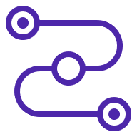
VPC Reachability Analyzer
Analyzes the configuration between two endpoints in a VPC
Doesn’t send/receive traffic
Returns a “reachable” or “not reachable”
“Not reachable” will identify the blocking component
Costs 10 cents (U.S.) each time it runs
Notes:
Well, Amazon thought of everything, and there’s a tool for that! It’s called the VPC Reachability Analyzer.
This analyzes the configuration between two endpoints in a VPC. This won’t go across VPC, but just within a single one. And importantly, this DOESN’T send traffic between the endpoints; it just looks at the configuration to see if there are any blockers to actual traffic that goes through.
After it runs the analysis, it’ll give you back a result of “reachable” or “not reachable.” And if not reachable, it’ll identify the blocking component.
This DOES cost to run this. It’s only 10 cents U.S., so not a huge amount, but just know that you will be charged each time you kick off the analyzer.

Slide 115

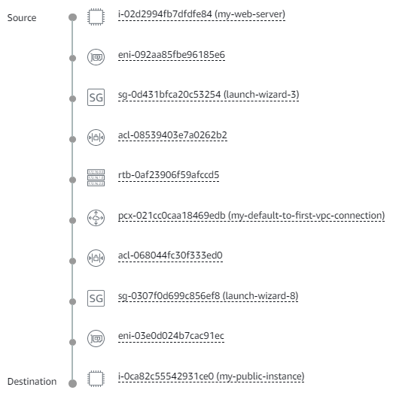
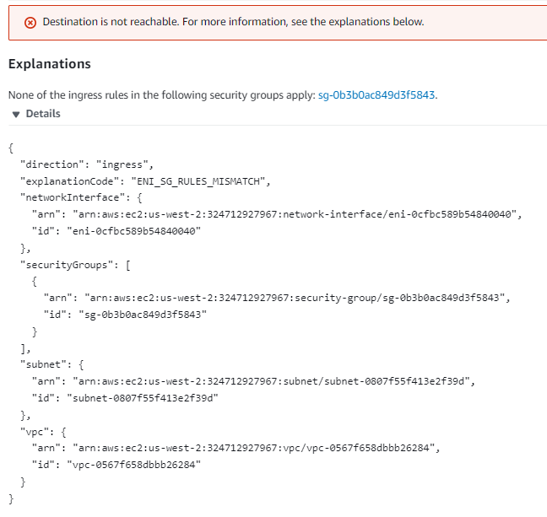
Notes:
And here are some examples of the results that will come back. If everything is good between the endpoints, you’ll get a “reachable,” and a visual showing the path. If you get a NOT reachable, then you’ll get details of what’s causing the issue so you can go investigate and fix it.

Slide 116
DEMO
Working with the VPC Reachability Analyzer
Notes:
m6-25 = “DEMO: Working with the VPC Reachability Analyzer”
In this demo, we’ll go in and work with the VPC Reachability Analyzer to look at our connection between two instances.
SETUP:
Start two instances in the public and private instances in my-first-vpc
We have two instances in the custom VPC we created. We’re calling them private instance and public instance, and they’re in the private and public subnets respectively, and have security groups associated with them. The private instance has a security group that allows SSH, but nothing else (show this).
VPC→Reachability Analyzer→New analysis
Source: public instance
Destination: private instance, over Port 80 (a little contrived…a private instance normally wouldn’t have port 80 open since that’s more for public-facing things, but just want to show you how you’d detect an issue with reachability)
Create
Doesn’t work. Should fail with explanation
None of the ingress rules in the following security groups apply: sg-0b3b0ac849d3f5843.
This means our ingress, or inbound rules, on this security group aren’t allowing traffic in.
Click into that security group, allow inbound traffic on Port 80, and then run again
Works
Show visualization
Go back and remove Port 80 from the rules for the private SG
Delete my-first-vpc and everything else in it

Slide 117
SHUT DOWN YOUR RESOURCES!
Notes:
m6-26 = “IMPORTANT! Shut Down Resources”
Delete VPC and everything else in it, including instances

Slide 118


Site-to-Site VPN
VPC
Corporate Data Center
Site-to-Site VPN
Public subnet
Private subnet
Encrypted
Uses public internet
Fast to set up
Notes:
m6-27 = “Site-to-Site VPN Overview”
Now let’s move on to talk about hybrid networking, where you need to connect from on-premises, a corporate data center, to AWS.
One option to do this is over VPN, using Site-to-Site VPN. This will be automatically (click) encrypted, but know that this DOES go over (click) the public internet so is not the most secure option. However, (click) it’s fast and easy to set up and relatively inexpensive.

Slide 119

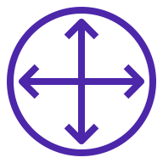
Site-to-Site VPN
VPC
Corporate Data Center
Site-to-Site VPN
Public subnet
Private subnet
Virtual Private
Gateway (VGW)
Customer Gateway (CGW)
Notes:
To set this up, there are two pieces. On the on-premises side (click), you’ll have a Customer Gateway, which you’ll commonly see abbreviated as CGW. This is a physical or software appliance that you, the customer, owns and manages. You’ll have to do the setup on this.
And then on the AWS side, you’ll need (click) a Virtual Private Gateway, commonly abbreviated as VGW, and this is what will allow you to talk to the resources in the various subnets within the VPC.

Slide 120
Site-to-Site VPN
VPC
Corporate Data Center
Site-to-Site VPN
Public subnet
Private subnet
Virtual Private
Gateway (VGW)
Customer Gateway (CGW)
Configure with public IP of CGW (if it has one)
Or with public IP of the NAT device in front of it
Notes:
On the CGW side, I don’t actually have one of these to do a demo with, but to give you the high-level setup…
You have two options (click). If the appliance itself has a public IP, then you’ll configure it to use that. Or, if it’s not public-facing, and it’s sitting behind a NAT device, then you’ll configure it with the public IP of the NAT device.

Slide 121
Site-to-Site VPN
VPC
Corporate Data Center
Site-to-Site VPN
Public subnet
Private subnet
Virtual Private
Gateway (VGW)
Customer Gateway (CGW)
In subnet route tables, enable Route Propagation
Notes:
And then on the AWS side, in the subnet routes tables, you need to enable Route Propagation in order to get this to work.

Slide 122
Site-to-Site VPN
VPC
Corporate Data Center
Site-to-Site VPN
Public subnet
Private subnet
Virtual Private
Gateway (VGW)
Customer Gateway (CGW)
In security groups, enable inbound ICMP access
Notes:
And finally, in the security groups for your EC2 instances, you’ll need to enable inbound ICMP access. So a few different components and steps to get this working properly, and these are things that might come up on the exam so I wanted to cover them here.

Slide 123
VPN CloudHub
Corporate Data Center
SEATTLE
VPC
Public subnet
Corporate Data Center
NEW YORK
Private subnet
Virtual Private
Gateway (VGW)
Corporate Data Center
AUSTIN
Notes:
You might also get questions about VPN CloudHub. This supports the scenario where you have multiple on-premises data centers that you’re trying to connect.
So you set up a connection between the VPN Gateway on the AWS side, and all of the Customer Gateways on the on-prem side. Just like you would normally, but you’re doing it for all three data centers in this case.
And that will enable the corporate data centers to not only (click) talk to AWS, but they can talk to each other too…the red arrows here showing connections between them.
So if you get any questions about connecting multiple on-prem data centers to AWS over VPN, then think CloudHub.

Slide 124

AWS Direct Connect
VPC
Corporate Data Center
Public subnet
Private subnet
Dedicated physical connection
Notes:
Have open: https://aws.amazon.com/directconnect/locations/
m6-28 = “Direct Connect Overview”
The second option for hybrid networking is AWS Direct Connect. This offers a dedicated physical connection from your on-premises data center to AWS.

Slide 125
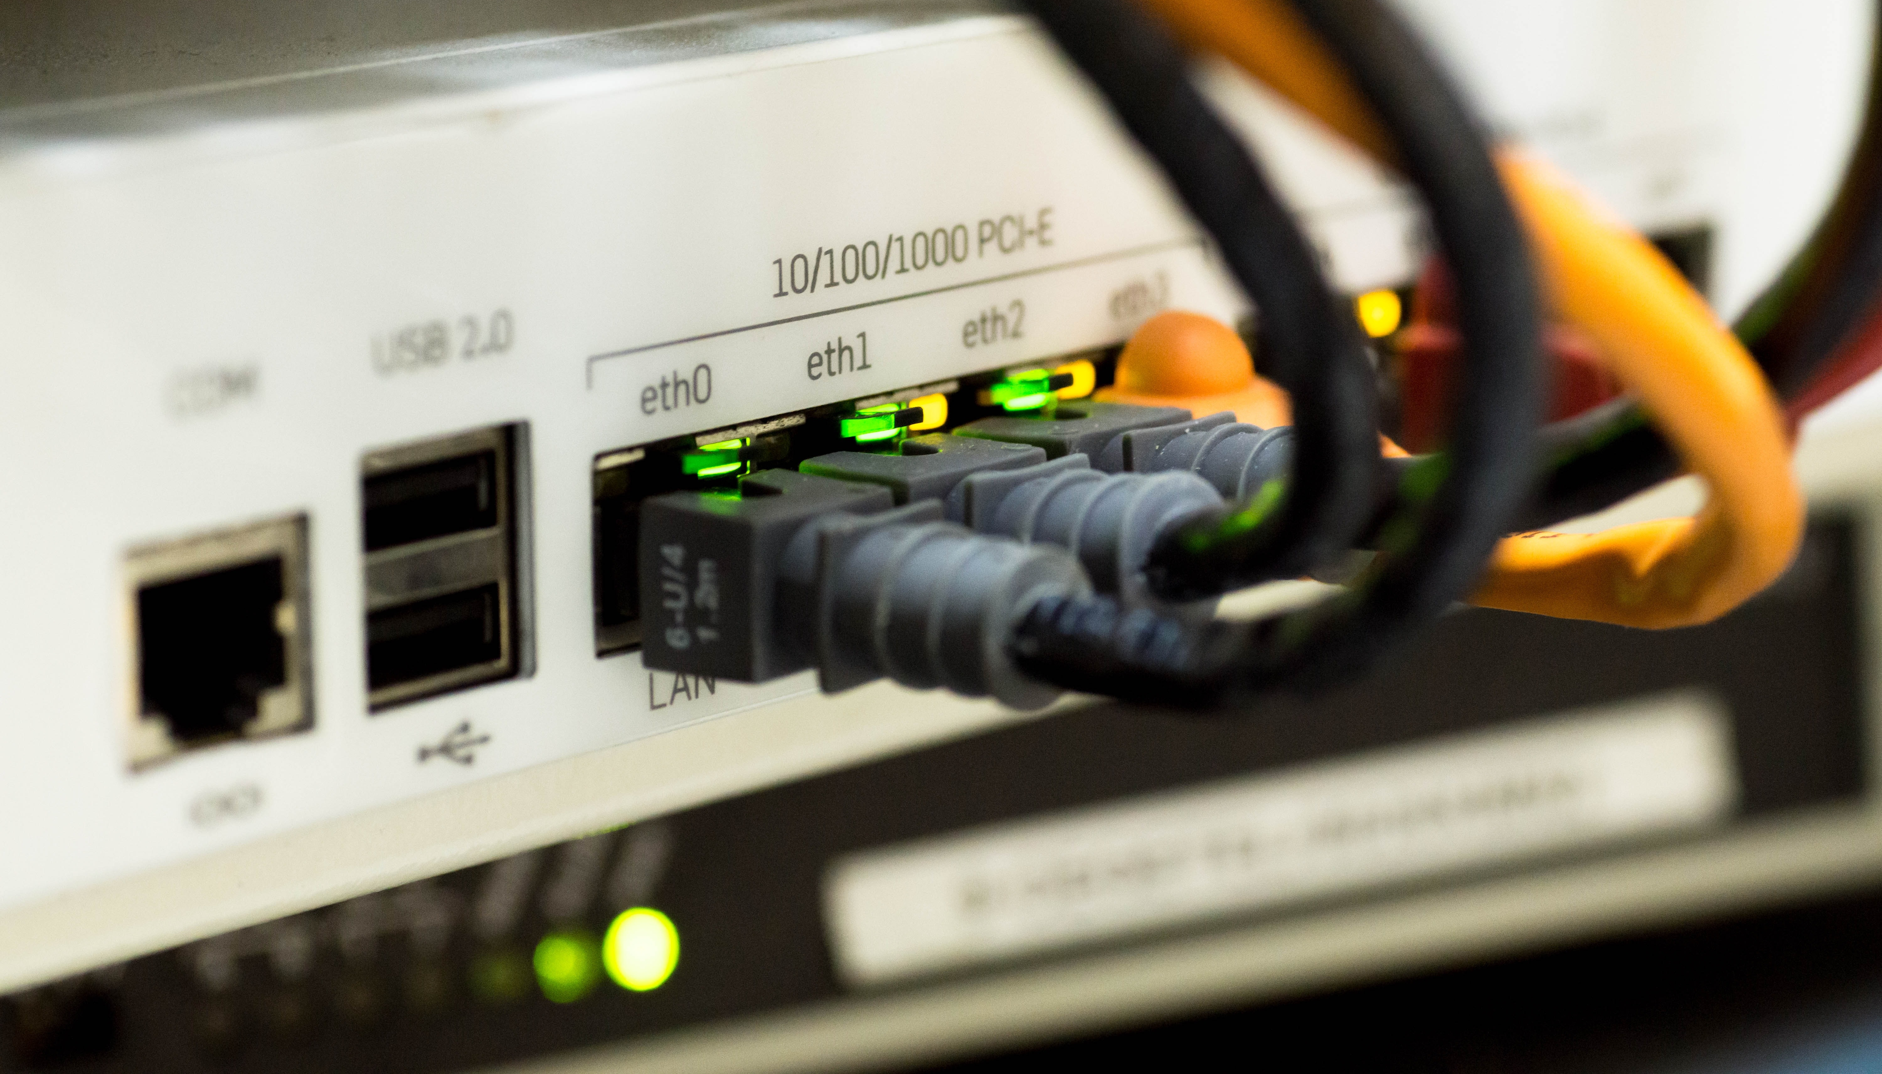
Notes:
As in, think physical cables, and working with your utility provider to ensure your lines connect to the AWS data center.

Slide 126
AWS Direct Connect
VPC
Corporate Data Center
Public subnet
Private subnet
Dedicated physical connection
Bypasses public internet; uses dedicated private network (not encrypted by default)
Faster and more expensive
Takes longer to set up
Notes:
(click to make the first bullet appear (covered in the previous slides).
(click) This bypasses the public internet, using a dedicated private network instead. By default, since you’re not going over the public internet, data is not encrypted.
(click) Because you have a dedicated connection, you’re not going to deal with the fluctuations you get over the public internet, and your baseline speed will be much faster. However, it comes at a cost, and will be much more expensive than the VPN option.
(click) And finally, it takes longer to set up and requires an expert team.

Slide 127
AWS Direct Connect
VPC
Direct Connect Location
Corporate Data Center
Public subnet
Direct Connect Endpoint
Customer Router
Customer Router/ Firewall
Virtual Private
Gateway (VGW)
Private subnet
Private virtual interface
Notes:
The way this works is, from the corporate data center, you’re going to connect to a Direct Connect Location (click). This is a physical location in the world. If you go to https://aws.amazon.com/directconnect/locations/, you’ll see all the locations.
On the outbound side (click), you’ll have a Direct Connect endpoint, which will connect to the virtual private gateway, or VGW, which you WILL need on your AWS side. This connection here will be a private virtual interface, into your VPC.

Slide 128
AWS Direct Connect
Region
VPC
Direct Connect Location
Corporate Data Center
Public subnet
Direct Connect Endpoint
Customer Router
Customer Router/ Firewall
Virtual Private
Gateway (VGW)
Private subnet
Public virtual interface
S3
Notes:
But you CAN also use this Direct Connect setup to access things outside of your VPC—say an S3 bucket or something like that. This connection will be using a PUBLIC virtual interface rather than private.
So those are the basics of Direct Connect. Obviously I can’t show you how to set this up in a demo, but on the exam, know that Direct Connect will be the more secure option that gives you a private connection from on-premises to AWS.

Slide 129

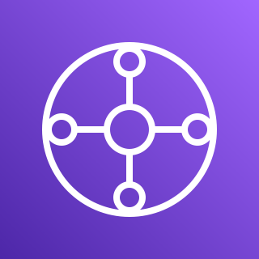
TRANSIT GATEWAY
Notes:
m6-29 = “Transit Gateway Overview”
At this point in the course, you’re probably again thinking, gosh, there are so many ways you can connect different parts of a network—you’ve got VPC peering, Direct Connect, Site-to-Site VPN—so many things. And setting all of those up and managing them might seem like a bit much. And/or getting them to work with each other might seem a bit much too.
And that’s where Transit Gateway comes in.

Slide 130
Transit Gateway
VPC
VPC
Transitive access among the VPCs (can’t do this with VPC peering)
VPC
VPC
Notes:
Transit Gateway is a hub-and-spoke or star model that lets you connect multiple VPCs together. And here (click), access is transitive, meaning from VPC 1, I can connect to VPC 2, 3 and 4, by going through the gateway. You’ll remember this isn’t possible with VPC peering; there, each VPC has to have a connection to every other VPC.

Slide 131
Transit Gateway
Site-to-Site VPN
VPC
VPC
VPC
VPC
Direct Connect
Notes:
This can also pull in your connections for Direct Connect or Site-to-Site VPN—so all of this goodness going through one central hub or gateway.

Slide 132

A hub; a place to make connections
Notes:
The way I remember this is like a transit hub in real life—where trains or busses, airplanes, etc. are coming in from various places, connect at the transit hub, and then off they go to other locations.

Slide 133
Other Notes about Transit Gateway
Sits at the region level
Supports cross-region, and can peer Transit Gateways together
To limit VPC access, update the route tables
Supports IP multicast
Multicast: delivers a single stream of data to multiple receiving computers simultaneously
Supports routing multicast traffic between subnets
Serves as a multicast router for instances
The only AWS service to support multicast
Notes:
A few other notes here. Transit Gateway is a regional resource, and it does support cross-region. You can even peer Transit Gateways together across regions.
As we saw, all VPCs can access all other VPCs, but presumably that’s not always something you want, so to prevent that, you’ll need to update the VPC route tables.
And then finally, Transit Gateway supports IP multicast. If you aren’t familiar with the term multicast, this is where we’re delivering a single stream of data to multiple receiving computers simultaneously. And Transit Gateway supports routing multicast traffic between subnets, and also serves as a multicast router for instances.
For purposes of the exam, just know that this is the only AWS service that has this multicast capability. You won’t need to know the details of how it works behind the scenes.

Slide 134
Important Points to Remember
VIRTUAL PRIVATE CLOUD (VPC)
Your own private cloud/network within the cloud that isolates your resources
Split into subnets
Public: has a route to an Internet Gateway
Private: does NOT have a route to an Internet Gateway; if you need to access the internet, use a NAT Gateway
VPCs are tied to a region and span multiple availability zones
IP Addressing
For CIDR blocks, the higher the network mask (the “slash number”), the fewer addresses available
e.g., /32 is a single IP address; /16 is 65,536 IP addresses
RFC 1918 addressing is for private addresses
Common ranges for AWS work are 172.* and 10.*
Route tables control the flow of traffic between different resources
Notes:
m6-30 = “Important Points to Remember”

Slide 135
Important Points to Remember
VIRTUAL PRIVATE CLOUD (VPC) (continued)
VPC endpoints allow you to access other AWS resources over the private AWS network (rather than the internet)
“Gateway” type endpoints are for S3 and DynamoDB; “Interface” type endpoints are for all other services
VPC Flow Logs give visibility into all network traffic (VPC level, subnet level, security group level, etc.)
NETWORK SECURITY
Network access control lists (ACLs) control traffic at the subnet level; stateless
Security groups control traffic at the EC2 instance level; stateful
ELASTIC NETWORK INTERFACES (ENIs)
A virtual network card
All EC2 instances (or their ENIs) have a private IP; can optionally have a public IP and Elastic (fixed, public) IP

Slide 136
Important Points to Remember
NETWORK ADDRESS TRANSLATION (NAT)
Translates a private address to a public address
Can be performed by: Internet Gateway, NAT Gateway and NAT Instance (no longer supported)
Bastion hosts can be used in a public subnet to allow SSH-ing into an instance in a private subnet (a “jump host”)
HYBRID NETWORKING
Site-to-Site VPN
Traffic is encrypted, but flows over the Internet
Inexpensive and easy to set up
Direct Connect
A dedicated physical connection (i.e., bypasses the Internet)
Data not encrypted by default
Faster performance, but takes longer to set up

Slide 137
Important Points to Remember
CONNECTING VPCs
VPC Peering allows multiple VPCs to behave as one
Transitive peering not allowed
Transit Gateway allows connection of multiple VPCs transitively
Also supports connections to Direct Connect and Site-to-Site VPN
Supports IP multicast
VPC Reachability Analyzer will analyze network configuration between two points in a VPC and identify any blocking components

